Slide 1
Computer & Information Security (372-1-460-1) Cryptographic Tools
Dept. of Software and Information Systems Engineering, Ben-Gurion University
Prof. Yuval Elovici, Dr. Asaf Shabtai, Dr. Mordechai Guri
{elovici, shabtaia}@bgu.ac.il, gurim@post.bgu.ac.il
Spring, 2019

Slide 2
Cryptography
Is
A powerful tool for protecting information
The basis for many security mechanisms
Mostly based on Math, logics and Statistics
Is not
The solution to all security problems
Reliable unless implemented properly
Reliable unless used properly
Notes:
קריפטוגרפיה עוזרת לנו להשיג לא מעט מהכלים שעליהם דיברנו במצגת הקודמת. זה
אחד מהכלים של אבטחת מידע. זה לא פתרון להכל
וצריך לדעת איך ליישם את זה ולהשתמש בזה כדי להשיג שירות בצורה הטובה ביותר

Slide 3
Use cases
UC1: Secure communication
UC2: Protect files via encryption
UC3: Secure cloud computing
UC4: Blockchain (bitcoin)

Slide 4
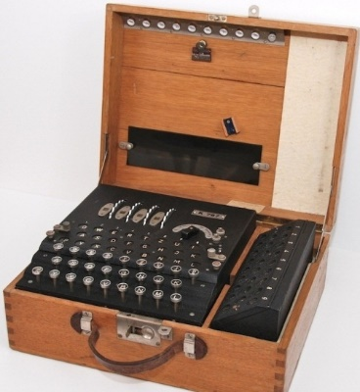
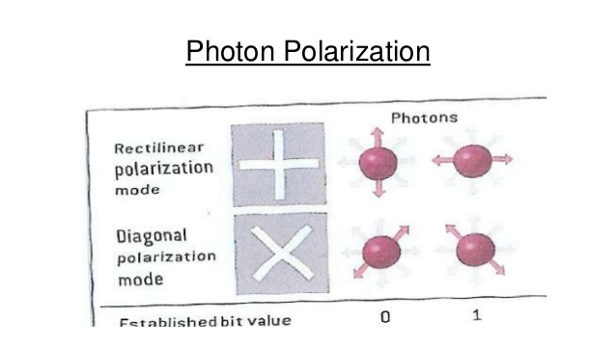
Cryptography techniques - history
Manual
Mechanical
Electro-mechanical
Electronic
Quantum cryptography (base on physical rules, uncertainty theorem etc.)

Slide 5
Cryptography - goals
Confidentiality
Integrity
Authenticity
Non-repudiation
Access control
Make attacks more difficult

Slide 6
Definitions
Cryptology
Cryptography (Kryptos = hidden, Graphia = writing)
Cryptanalysis
Input: Plaintext
Cryptosystem
Algorithm
Key/Key space
Output: Ciphertext

Slide 7
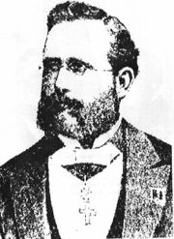
Auguste Kerckhoffs (1835)
"The system should be, if not theoretically unbreakable, unbreakable in practice"
Kerckhoffs principle: a cryptosystem should be secure even if everything about the system, except the secret key, is public knowledge.
Notes:
חוקר בתחום הקריפטוגרפיה , הולנדי , קירחוף .
הוא קבע חוקים , עיקרונות מנחים בקריפטוגרפיה. הוא קבע 6 עקרונות ואנו נציג שניים מהם:
- אחד הדברים שנדרוש ממערכת ההצפנה , גם אם לא הצלחנו להוכיח שהיא בלתי פריצה נוכל להראות מעשית שהיא לא פריצה , מעשית הכוונה שיקח לתוקף זמן לא סביר לפרוץ אותה.
-המערכת צריכה להיות בנויה בצורה כזאת שהדבר היחיד שהוא לא גלוי זה המפתח , צריך להניח שכל אחד יודע איך המערכת עובדת , הדבר היחיד ששמור כסוד זה המפתח

Slide 8

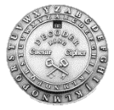

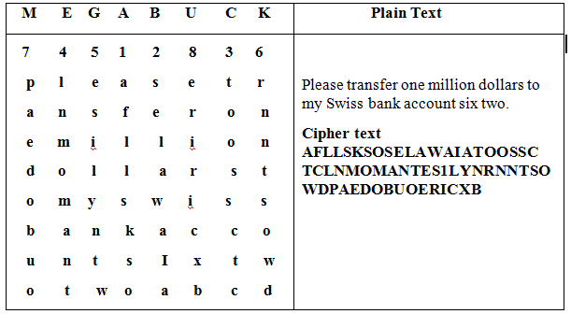
Cryptosystems’ Main Categories
Substitution | Transposition | One time pad | Symmetric (Single Key) | Asymmetric (Two Keys) (PKE)
Mono alphabetic (Ceaser Cipher) | Scytale Rod | Vernum Cipher | Block Cipher (DES, Triple DES, AES, RC5, RC6) | RSA, Diffie – Helman DSS ECC
Poly alphabetic (Vigenere cipher) | Basic Transposition |  | Stream Cipher (RC4)
Notes:
סיכום של מנגנוני הצפנה לפי קטגוריות

Slide 9
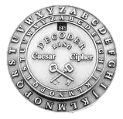
Basic cryptosystems - Substitution
Caesar cipher
Mono-alphabetic cipher
key = the offset
Simple to break
Notes:
יש מספר צורות בהם נוכל להשיג הצפנה, הטכניקה הראשונה היא החלפה. הדוגמא הראשונה היא ידנית.
מה שרואים כאן , המעגל החיצוני הוא סט האותיות והמעגל הפנימי הוא מפתח ,
נסובב את המעגל הפנימי ומציבים אות מסוימת מול אות מסוימת באלף-בית ולמעשה זו תהיה האות המוחלפת.
המפתח כאן הוא התאמה בין אות אחת לשנייה.

Slide 10

Basic cryptosystems - Substitution
Vigenere cipher (1586) – polyalphabetic cipher
Key = boy (X axis)
Plaintext = hello (Y axis)
Cipher = isjmc
More complicated to break
The frequency of the letters appears in the cipher is different
Notes:
In order to encrypt the word “Hello” with the Key “Boy”
Go to column “B” – and find the row in which we find “H” on the axis – the mutual letter is “i” therefore we take it as the first one = “i”
Go to column “O” – and find the row in which we find “E” on the axis– the mutual letter is “S” therefore we take it as the second one = “s”
We keep on it till we finish – in case that they key is shorter than the plaintext we duplicate the key’s letters on the same appearance order.
In Oder to Decrypt the Cipher “isjmc” with the Key “Boy”
Go to column “B” – and find the row in which we find “i” inside the table – the letter on the axis is “H” therefore we take it as the first one = “H”
Go to column “O” – and find the row in which we find “s” inside the table – the mutual letter is “S” therefore we take it as the second one = “E”
And so on.

Slide 11
Monoalphabetic Substitution
So 26! ~= 4 x 10²⁶ possible mappings
Testing 10⁶/sec would take 10¹³ years
Is it secure?
All natural languages have statistical properties (most common letters, digrams, trigrams, word endings, doubled letters, words)
Notes:
אם נבדוק את כל המפתחות האפשריים ( brut force ) זה יצריך זמן רב. אולם זה לא אופטימלי ,
יש סטטיסטיקות שמייחדות את השפה ,
אם למשל נצפין בשפה האנגלית נדע אילו אותיות ייותר שכיחות , סיומות וכו'. חוקי שפה.

Slide 12
Letter Frequency
Letter | % | Letter | %
E | 13.0 | A | 7.3
T | 9.3 | S | 6.3
N | 7.8 | D | 4.4
R | 7.7 | H | 3.5
I | 7.4 | L | 3.5
O | 7.4 | C | 3.0

Slide 13
Frequency of Usage
Digrams
Trigrams
Doubles
Endings
Words
the
of
are
I
and
you
a
can
to
he
her
that
in
was
is
has
it
him
his
th
he
at
st
an
in
ea
nd
er
en
re
nt
to
es
on
ed
ti
the
and
tha
hat
ent
ion
for
tio
has
edt
tis
ers
res
ter
con
ing
men
ll
tt
ss
ee
pp
oo
rr
ff
cc
dd
nn
e
t
s
d
n
r
y

Slide 14
Decrypting a Substitution Cipher
Count relative frequency of letters, digrams, trigrams, endings, doubles, and words in the ciphertext
If you have enough encrypted text, it can be analyzed and broken by high-speed computers
But must have a body of encrypted text of sufficient size to permit analysis
Notes:
המידע הסטטיסטי מאפשר לנו לקצר את פרק הזמן שבו לוקח לפענח את ההצפנה , הצפנות מהסוג הזה ניתן לפרוץ מאוד מהר.
זה דורש ידע מקדים על מה אנחנו מצפינים , אם יודעים שמצפינים טקסט באנגלית אז נדע להוציא את השכיחויות משם וכל הסטטיסטיקות.
מצד שני אם לא יודעים באיזה שפה זה הוצפן, זה יהיה יותר קשה.

Slide 15
Transposition Ciphers
Repeated letters in the plaintext results in repeated letters in the ciphertext
Need to break the repetition relationship between letters in the plaintext and the cipher
➔ transposition cipher
Notes:
החלפת מקום של אותיות.

Slide 16
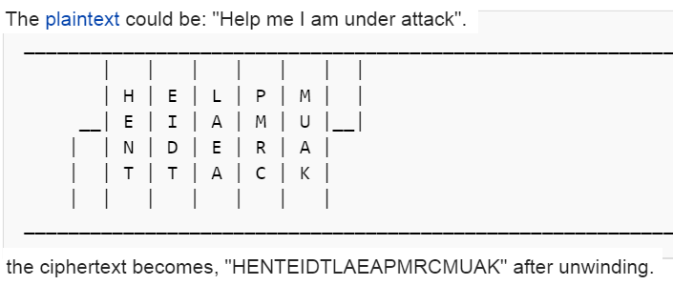
Basic cryptosystems - Transposition
Scytale Rod (Sparta 400BC)
The ancient Greeks, and the Spartans used this cipher during wars.
Key = Both sender and receiver use rod with the same diameter.
The plaintext and the cypher were written on the same leather.

Slide 17
Basic cryptosystems - Transposition
Notes:
בוחרים מפתח שהוא רצף תווים , לדוגמא MEGABUCK
כותבים את הטקסט לפי האורך של המפתח.
בשורות לאורכו של המפתח.
איך מתבצעת ההצפנה? קובעים את סדר העמודות לפי סדר האלף-בית .
לוקחים את העמודה של a ורושמים את כל האותיות שמרכיבות את העמודה(לפי סדרך הa b c )
איך מתבצע הפיענוח?
למקבל יש גם את המפתח – והוא שופך את ה CHIPHER לפי סדר ה א' ב' ואז בסוך קוראים שורות שורות את הצופן המפוענח.

Slide 18
One-Time Pad
Vernam cipher (Gilbert Vernam), 1917
Mathematically unbreakable –
has a property termed perfect secrecy;
ciphertext gives absolutely no additional information about the plaintext
Generated randomly
Same length as the plaintext
Never reused
Notes:
הצפנה שהוכחה בצורה מתמטית שלא ניתן לפרוץ אותה ,
מתייחסים אליה כאל perfect cypher , המשמעות היא שאם יש cypher text מסוים הוא לא יתן לי שום מידע על הplain text .
המשמעות של ה plain text היא , שהמפתח מיוצר בצורה רנדומאלית , שני האלמנטים שנותנים לו את היכולת להוכיח שהוא בלתי פריץ :
- אורך המפתח הוא באורך הטקסט
-לא משתמשים באותו מפתח פעמיים

Slide 19
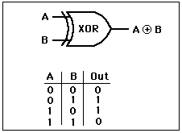
One-Time Pad
key=‘cat’= 01100011 01100001 01110100
P=‘dog’=
01100100 01100100 01100111
Cipher=
00000111 00000101 00010011
‘d’=100₁₀=01100100₂
‘o’=111₁₀=01101111₂
‘g’=103₁₀=01100111₂

Slide 20
One-Time Pad
Choose a random bit string as a key
Convert plaintext into bitstring
Compute exclusive-or of the two strings
Ciphertext contains no redundancy information because every combination is equally likely
Key must be at least as long as message- overhead

Slide 21
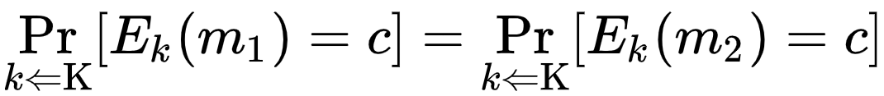
One-Time Pad
Challenges:
Key can not be memorized (too long)
Difficulties to create natural Random
Large over head
Why it works?

Slide 22
Secure cryptosystem
Problems
Statistical patterns
Redundancies
Key smaller than plaintext
Key reused
Solutions
substitutions
Transposition
Compression
Expansion
Padding
Key mixing
Initialization vector (IV)

Slide 23
Symmetric Encryption
The universal technique for providing confidentiality for data at rest/motion
Also referred to as conventional encryption or single-key encryption
Two security requirements:
Need a strong encryption algorithm
Sender and receiver must agree on the secret key in a secure fashion (handshake) and must keep the key secured.
Notes:
The universal technique for providing confidentiality for transmitted or stored data is symmetric encryption.
Symmetric encryption, also referred to as conventional encryption or single-key encryption, was the only type of encryption in use prior to the introduction of public-key encryption in the late 1970s.
Countless individuals and groups, from Julius Caesar to the German U-boat force to present-day diplomatic, military, and commercial users, have used symmetric encryption for secret communication.
It remains the more widely used of the two types of encryption.
There are two requirements for secure use of symmetric encryption:
1. We need a strong encryption algorithm. At a minimum, we would like the
algorithm to be such that an opponent who knows the algorithm and has access to one or more ciphertexts would be unable to decipher the ciphertext
or figure out the key. This requirement is usually stated in a stronger form:
The opponent should be unable to decrypt ciphertext or discover the key even if he or she is in possession of a number of ciphertexts together with the plaintext that produced each ciphertext.
2. Sender and receiver must have obtained copies of the secret key in a secure
fashion and must keep the key secure. If someone can discover the key and knows the algorithm, all communication using this key is readable.

Slide 24
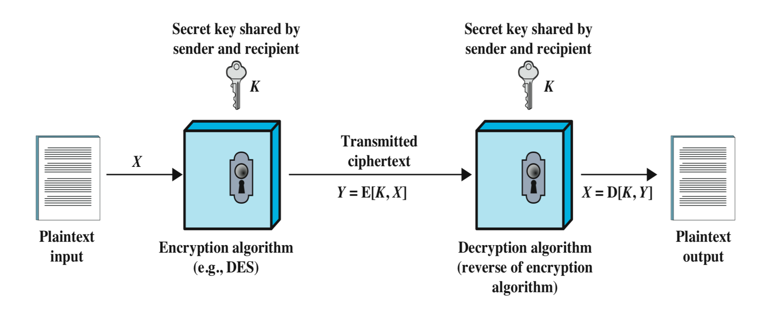
Symmetric Encryption [43]
Notes:
A symmetric encryption scheme has five ingredients:
• Plaintext: This is the original message or data that is fed into the algorithm as input.
• Encryption algorithm: The encryption algorithm performs various substitutions and transformations on the plaintext.
• Secret key: The secret key is also input to the encryption algorithm. The exact substitutions and transformations performed by the algorithm depend on the key.
• Ciphertext: This is the scrambled message produced as output. It depends on the plaintext and the secret key. For a given message, two different keys will produce two different ciphertexts.
• Decryption algorithm: This is essentially the encryption algorithm run in reverse. It takes the ciphertext and the secret key and produces the original plaintext.

Slide 25
Symmetric Encryption
Two classes
Block (RC5, RC6, Blowfish…)
Stream (RC4)

Slide 26
Cryptanalytic Attacks
Rely on:
nature of the algorithm
some knowledge of the general characteristics of the plaintext
some sample plaintext-ciphertext pairs
Exploits the
characteristics of the algorithm to attempt to deduce a specific plaintext or the key being used
If successful
all future and past messages encrypted with that key are compromised

Slide 27
Brute-Force Attack
Try all possible keys on some ciphertext
Try until an intelligible translation into plaintext is obtained
On average half of all possible keys must be tried to achieve success

Slide 28
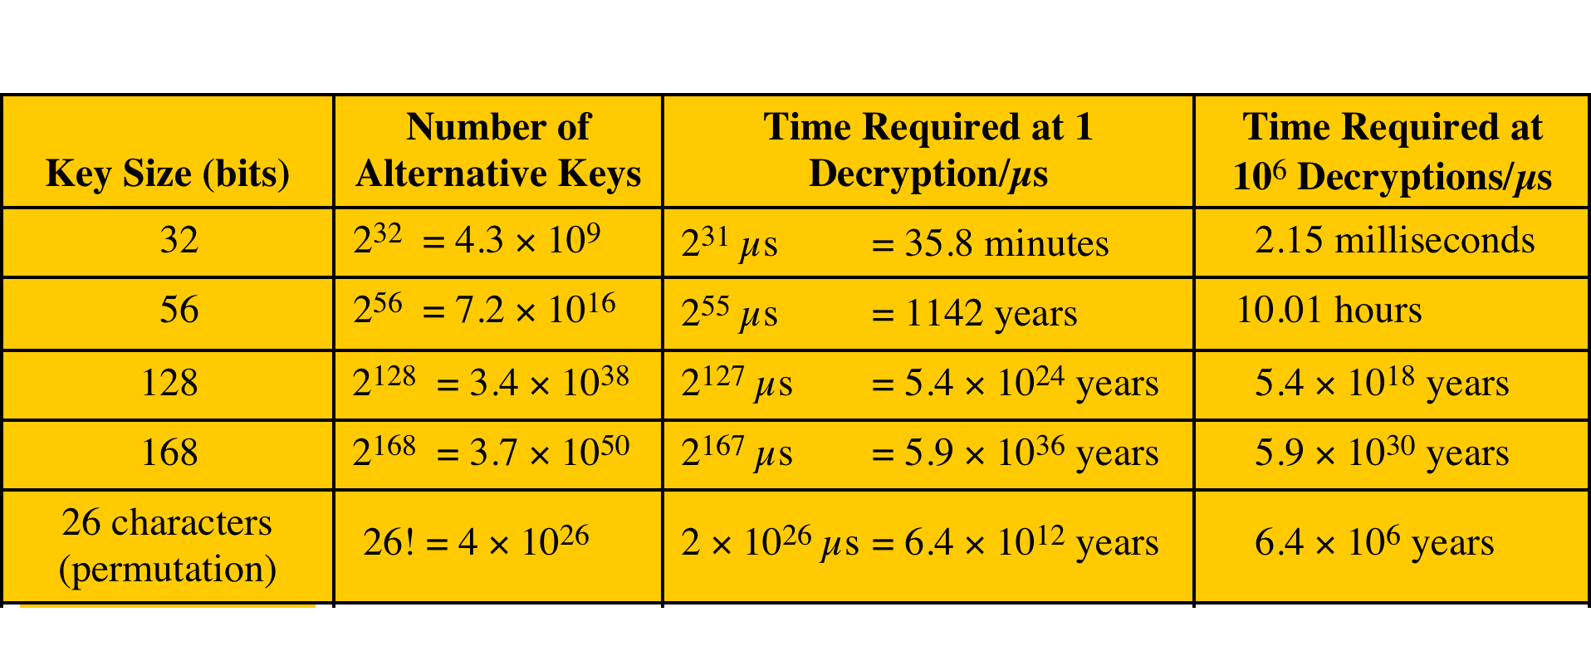
Average Time Required for Exhaustive Key Search
Assuming the decryption takes
1 key in 1 micro-second
1M key in 1 micro second
Notes:
The table shows how much time is involved for various key sizes.
With microprocessors, it may be possible to achieve processing rates many orders of magnitude greater.
The final column considers the results for a system that can process 1 million keys per microsecond.
At this performance level, a 56-bit key is no longer computationally secure.

Slide 29
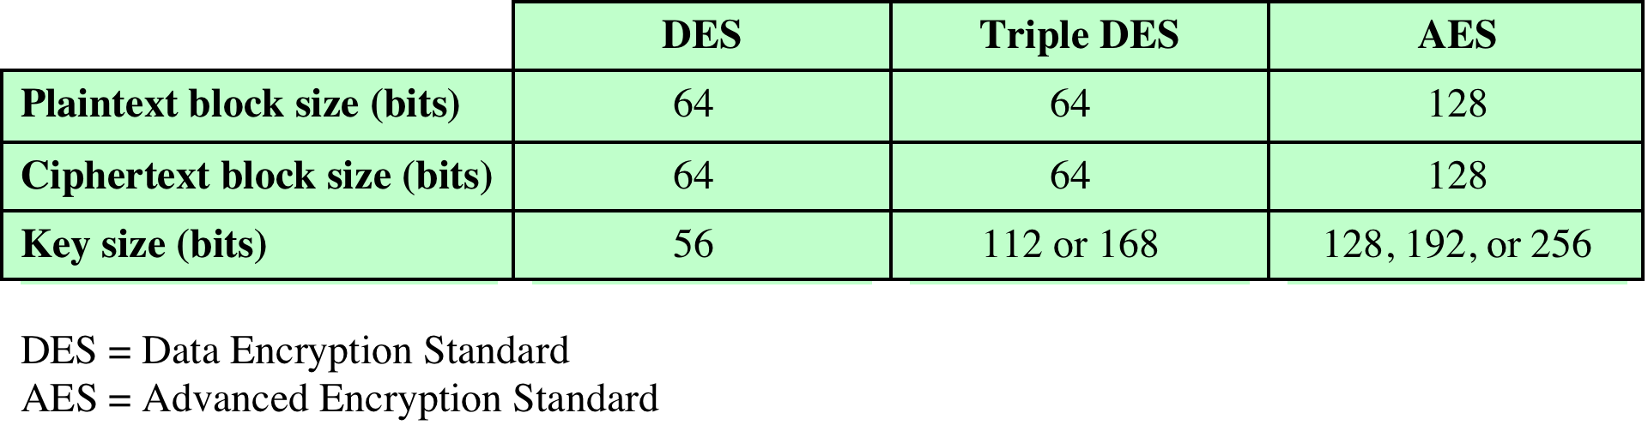
Comparison of three Popular Symmetric Encryption Algorithms
Block cipher - most commonly used in symmetric encryption
Input = Fixed-size blocks
Output = Fixed-size equals to the input
Notes:
The most commonly used symmetric encryption algorithms are block ciphers.
A block cipher processes the plaintext input in fixed-size blocks and produces a block of ciphertext of equal size for each plaintext block.
The algorithm processes longer plaintext amounts as a series of fixed-size blocks.
The most important symmetric algorithms, all of which are block ciphers, are the Data Encryption Standard (DES), triple DES, and the Advanced Encryption Standard (AES).

Slide 30
Data Encryption Standard (DES)
Adopted by NIST in 1977
Uses
64 bit plaintext block
56 bit key to
produce a 64 bit ciphertext block
DES is the most studied encryption algorithm in existence
Electronic Frontier Foundation (EFF) announced in July 1998 that it had broken a DES encryption using the “DES cracker” (250K$ hardware)
Notes:
The most widely used encryption scheme is based on the Data Encryption Standard (DES) adopted in 1977 by the National Bureau of Standards, now the National Institute of Standards and Technology (NIST), as Federal Information Processing Standard 46 (FIPS PUB 46).
The algorithm itself is referred to as the Data Encryption Algorithm (DEA).
DES takes a plaintext block of 64 bits and a key of 56 bits, to produce a ciphertext block of 64 bits.
Concerns about the strength of DES fall into two categories: concerns about the algorithm itself and concerns about the use of a 56-bit key.
The first concern refers to the possibility that cryptanalysis is possible by exploiting the characteristics of the DES algorithm.
Over the years, there have been numerous attempts to find and exploit weaknesses in the algorithm, making DES the most-studied encryption
algorithm in existence. Despite numerous approaches, no one has so far reported a fatal weakness in DES.
A more serious concern is key length. With a key length of 56 bits, there are 2⁵⁶ possible keys, which is approximately 7.2 x 10¹⁶ keys.
Thus, on the face of it, a brute-force attack appears impractical.
Assuming that, on average, half the key space has to be searched, a single machine performing one DES encryption per micro second would take more than a thousand years to break the cipher.
However, the assumption of one encryption per microsecond is overly conservative.
DES finally and definitively proved insecure in July 1998, when the Electronic Frontier Foundation (EFF) announced that it had broken a DES encryption
using a special-purpose “DES cracker” machine that was built for less than $250,000.
The attack took less than three days. The EFF has published a detailed description of the machine, enabling others to build their own cracker [EFF98].
And, of course, hardware prices will continue to drop as speeds increase, making DES virtually worthless.
It is important to note that there is more to a key-search attack than simply running through all possible keys.
Unless known plaintext is provided, the analyst must be able to recognize plaintext as plaintext.
If the message is just plain text in English, then the result pops out easily, although the task of recognizing English would have to be automated.
If the text message has been compressed before encryption, then recognition is more difficult.
And if the message is some more general type of data, such as a numerical file, and this has been compressed, the problem becomes even more difficult to automate.
Thus, to supplement the brute-force approach, some degree of knowledge about the expected plaintext is needed, and some means of automatically distinguishing plaintext from garble is also needed. The EFF approach addresses this issue as well and introduces some automated techniques that would be effective in many contexts.
A final point: If the only form of attack that could be made on an encryption algorithm is brute force, then the way to counter such attacks is obvious: Use longer
keys.
To get some idea of the size of key required, let us use the EFF cracker as a basis for our estimates. The EFF cracker was a prototype and we can assume that
with today’s technology, a faster machine is cost effective. If we assume that a cracker can perform 1 million decryptions per μs, which is the rate used in Table 2.1, then a DES code would take about 10 hours to crack. This is a speed-up of approximately a factor of 7 compared to the EFF result

Slide 31
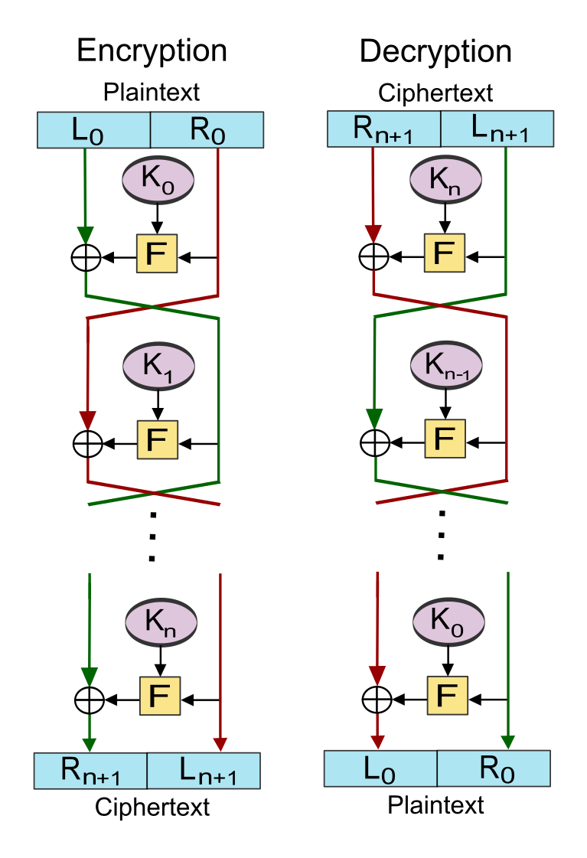
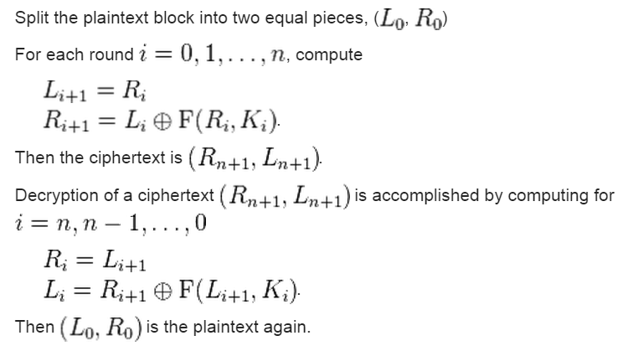
How does DES work? (Feistel Network) [597]
Plaintext is a block of length 2w bits
K is the Key (seed) from which the subkeys ki are being generated using a generation algorithm.
Plaintext is divided into two halves of length w: L0 and R0.
F is a function that combines between Ri and Ki
N –rounds, and the steps are:

Slide 32
Triple DES (3DES)
Repeats basic DES algorithm three times using either two or three unique keys
First standardized for use in financial applications in ANSI standard X9.17
Attractions:
168-bit key length overcomes the vulnerability to brute-force attack of DES
underlying encryption algorithm is the same as in DES
Drawbacks:
algorithm is slow in software
uses a 64-bit block size
Notes:
The life of DES was extended by the use of triple DES (3DES), which involves repeating the basic DES algorithm three times, using either two
or three unique keys, for a key size of 112 or 168 bits. Triple DES (3DES) was first standardized for use in financial applications in ANSI standard X9.17 in 1985.
3DES was incorporated as part of the Data Encryption Standard in 1999, with the publication of FIPS PUB 46-3.
3DES has two attractions that assure its widespread use over the next few years.
First, with its 168-bit key length, it overcomes the vulnerability to brute-force attack of DES.
Second, the underlying encryption algorithm in 3DES is the same as in DES.
This algorithm has been subjected to more scrutiny than any other encryption algorithm over a longer period of time, and no effective cryptanalytic attack
based on the algorithm rather than brute force has been found.
Accordingly, there is a high level of confidence that 3DES is very resistant to cryptanalysis.
If security were the only consideration, then 3DES would be an appropriate choice for a standardized encryption algorithm for decades to come.
The principal drawback of 3DES is that the algorithm is relatively sluggish in software.
The original DES was designed for mid-1970s hardware implementation and does not produce efficient software code. 3DES, which requires three times as
many calculations as DES, is correspondingly slower. A secondary drawback is that both DES and 3DES use a 64-bit block size. For reasons of both efficiency and security, a larger block size is desirable.

Slide 33
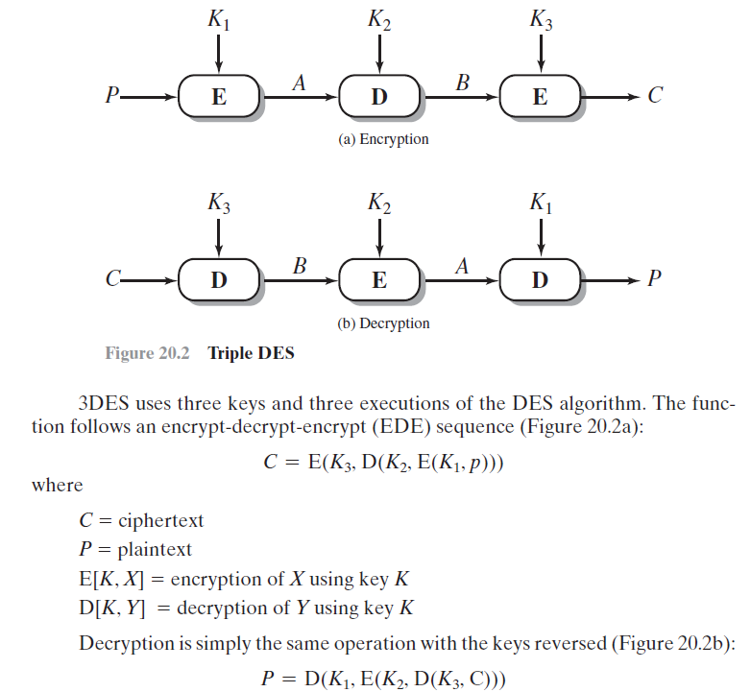
3DES – Scheme [630]
Notes:
The life of DES was extended by the use of triple DES (3DES), which involves repeating the basic DES algorithm three times, using either two
or three unique keys, for a key size of 112 or 168 bits. Triple DES (3DES) was first standardized for use in financial applications in ANSI standard X9.17 in 1985.
3DES was incorporated as part of the Data Encryption Standard in 1999, with the publication of FIPS PUB 46-3.
3DES has two attractions that assure its widespread use over the next few years.
First, with its 168-bit key length, it overcomes the vulnerability to brute-force attack of DES.
Second, the underlying encryption algorithm in 3DES is the same as in DES.
This algorithm has been subjected to more scrutiny than any other encryption algorithm over a longer period of time, and no effective cryptanalytic attack
based on the algorithm rather than brute force has been found.
Accordingly, there is a high level of confidence that 3DES is very resistant to cryptanalysis.
If security were the only consideration, then 3DES would be an appropriate choice for a standardized encryption algorithm for decades to come.
The principal drawback of 3DES is that the algorithm is relatively sluggish in software.
The original DES was designed for mid-1970s hardware implementation and does not produce efficient software code. 3DES, which requires three times as
many calculations as DES, is correspondingly slower. A secondary drawback is that both DES and 3DES use a 64-bit block size. For reasons of both efficiency and security, a larger block size is desirable.

Slide 34
Advanced Encryption Standard(AES)
NIST call for proposal for a new Advanced Encryption Standard (AES) in 1997
Selected Rijndeal in Nov. 2001 (also known as AES)
Advantages:
Faster than 3DES
security strength equal or better than 3DES
symmetric block cypher
Larger Blocks: 128bit blocks
Longer keys: 128/192/256 bit key
Notes:
Because of its drawbacks, 3DES is not a reasonable candidate for long-term use.
As a replacement, NIST in 1997 issued a call for proposals for a new Advanced Encryption Standard (AES), which should have a security strength equal to or better than 3DES and significantly improved efficiency.
In addition to these general requirements, NIST specified that AES must be a symmetric block cipher with a block length of 128 bits and support for key
lengths of 128, 192, and 256 bits.
Evaluation criteria included security, computational efficiency, memory requirements, hardware and software suitability, and flexibility.
In a first round of evaluation, 15 proposed algorithms were accepted. A second round narrowed the field to 5 algorithms.
NIST completed its evaluation process and published a final standard (FIPS PUB 197) in November of 2001.
NIST selected Rijndael as the proposed AES algorithm.
AES is now widely available in commercial products.

Slide 35
Symmetric Encryption Types
Block Cipher
Processes the input one block of elements at a time and produces an output block for each input block.
Implemented via different modes.
Stream cipher
Encrypts plaintext one byte at a time (also other units)
Processes the input elements continuously

Slide 36
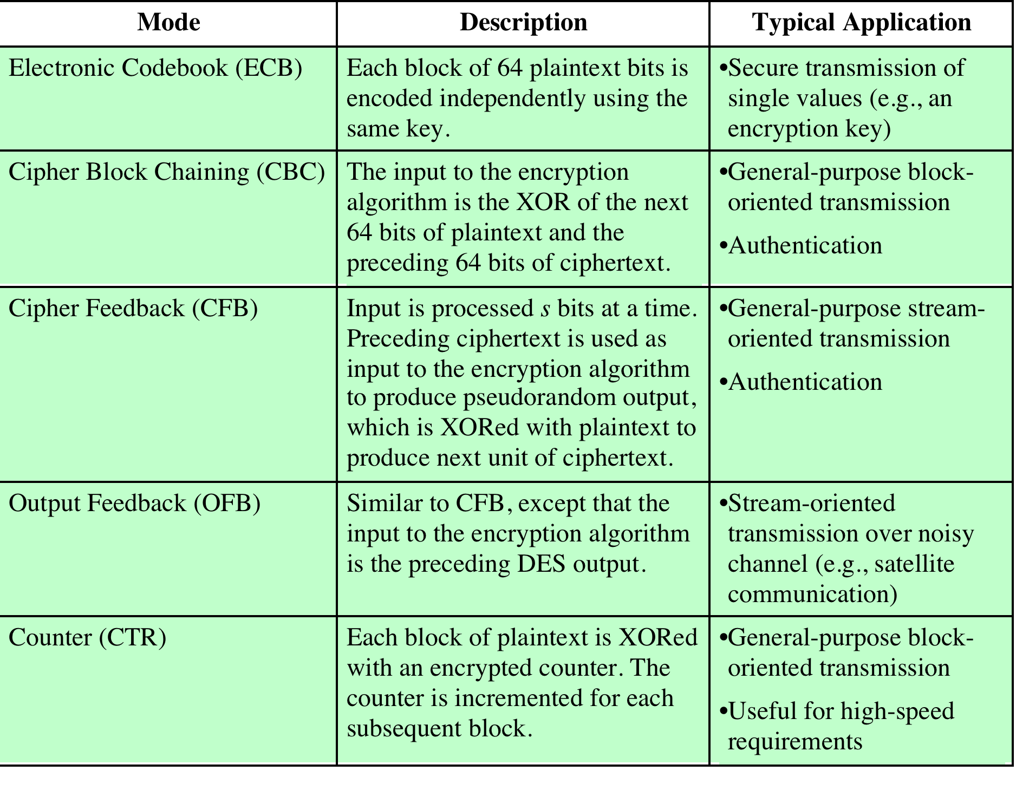
Modes of Operation [612]
Notes:
A symmetric block cipher processes one block of data at a time. In the case of DES
and 3DES, the block length is 64 bits. For longer amounts of plaintext, it is necessary
to break the plaintext into 64-bit blocks (padding the last block if necessary).
To apply a block cipher in a variety of applications, five modes of operation have been defined by NIST (Special Publication 800-38A). The five modes are intended
to cover virtually all the possible applications of encryption for which a block cipher
could be used. These modes are intended for use with any symmetric block cipher,
including triple DES and AES. The modes are summarized in Table 20.4 , and the
most important are described briefly in the remainder of this section.

Slide 37
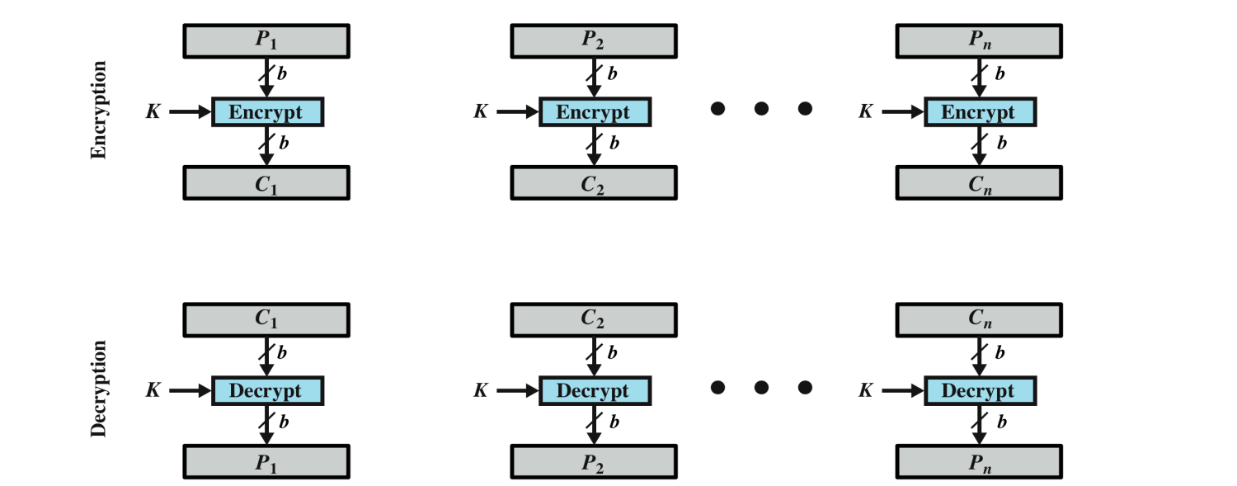
Block Cipher Encryption
Processes the input one block of elements at a time and produces an output block for each input block
Plaintext is handled using Electronic Code Book (ECB) For lengthy messages ECB mode is not secure especially if:
it is known that messages starts with certain predefined fields
keys are being reused
Notes:
The ECB mode. A plaintext of length nb is divided into n b-bit blocks (P1, P2,c,Pn).
Each block is encrypted using the same algorithm and the same encryption key, to
produce a sequence of n b-bit blocks of ciphertext (C1, C2,c,Cn).

Slide 38
Practical Security Issues
Typically symmetric encryption is applied to a unit of data larger than a single 64-bit or 128-bit block
Electronic codebook (ECB) mode is the simplest approach to multiple-block encryption
each block of plaintext is encrypted using the same key
cryptanalysts may be able to exploit regularities in the plaintext
Modes of operation
Alternative techniques developed to increase the security of symmetric block encryption for large sequences
Overcomes the weaknesses of ECB
To increase security for lengthy messages we use Stream Cipher
Notes:
Typically, symmetric encryption is applied to a unit of data larger than a single 64-bit or 128-bit block. E-mail messages, network
packets, database records, and other plaintext sources must be broken up into a series of fixed-length block for encryption by a symmetric block cipher. The simplest approach to multiple-block encryption is known as electronic codebook (ECB)
mode, in which plaintext is handled b bits at a time and each block of plaintext is encrypted using the same key. Typically b 64 or b 128
For lengthy messages, the ECB mode may not be secure. A cryptanalyst may be able to exploit regularities in the plaintext to ease the task of decryption. For
example, if it is known that the message always starts out with certain predefined fields, then the cryptanalyst may have a number of known plaintext-ciphertext pairs to work with.
To increase the security of symmetric block encryption for large sequences of data, a number of alternative techniques have been developed, called modes of
operation. These modes overcome the weaknesses of ECB; each mode has its own particular advantages.

Slide 39
Electronic Codebook (ECB)
Simplest mode
Plaintext is handled b bits at a time and each block is encrypted using the same key
“codebook” because have unique ciphertext value for each plaintext block
Notes:
The simplest way to proceed is what is known as electronic codebook (ECB) mode,
in which plaintext is handled b bits at a time and each block of plaintext is encrypted
using the same key ( Figure 2.3a ). The term codebook is used because, for a given
key, there is a unique ciphertext for every b -bit block of plaintext. Therefore, one
can imagine a gigantic codebook in which there is an entry for every possible b -bit
plaintext pattern showing its corresponding ciphertext.
With ECB, if the same b -bit block of plaintext appears more than once in
the message, it always produces the same ciphertext. Because of this, for lengthy
messages, the ECB mode may not be secure. If the message is highly structured,
it may be possible for a cryptanalyst to exploit these regularities. For example, if
it is known that the message always starts out with certain predefined fields, then
the cryptanalyst may have a number of known plaintext-ciphertext pairs to work
with. If the message has repetitive elements, with a period of repetition a multiple
of b bits, then these elements can be identified by the analyst. This may help in the
analysis or may provide an opportunity for substituting or rearranging blocks.
To overcome the security deficiencies of ECB, we would like a technique in
which the same plaintext block, if repeated, produces different ciphertext blocks.

Slide 40
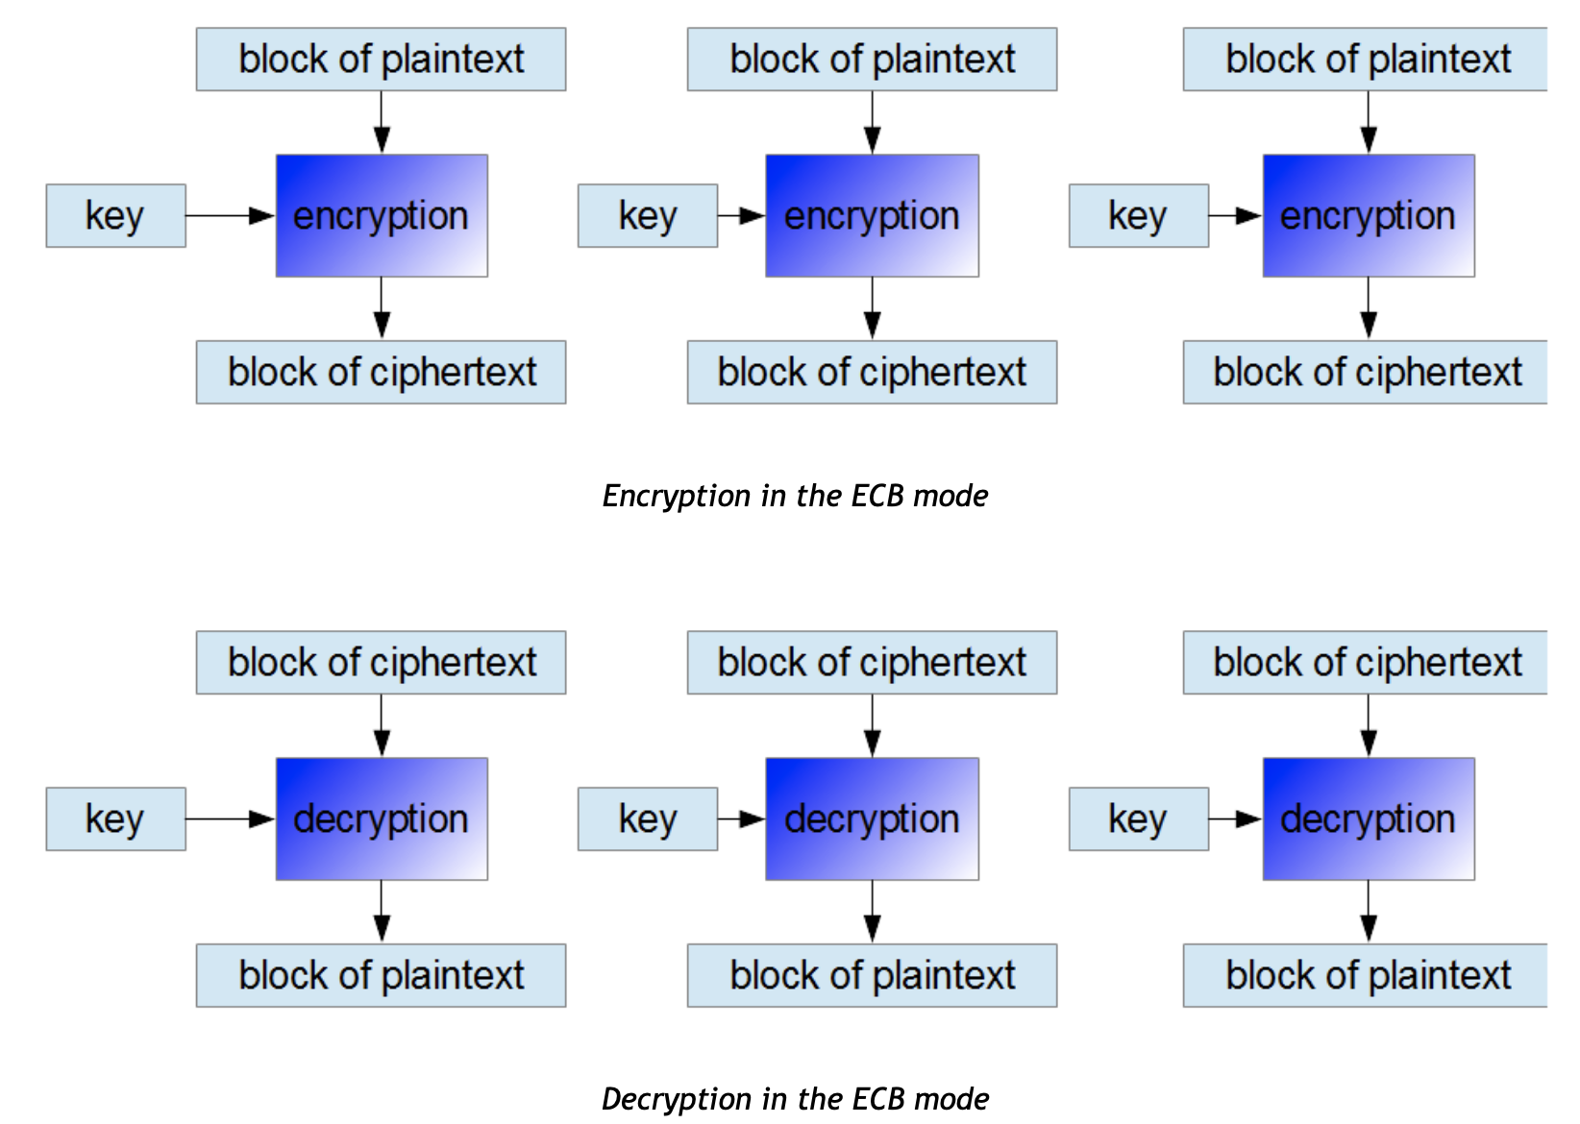
Electronic Codebook (ECB)

Slide 41
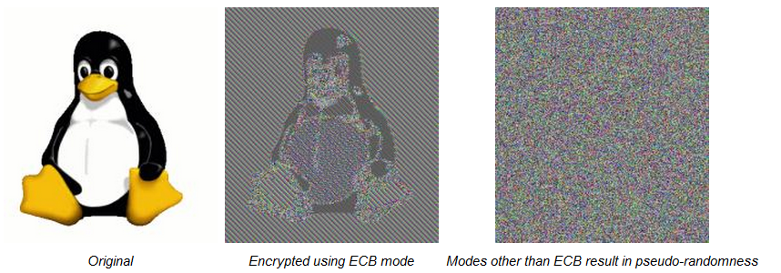
ECB Analysis
Security:
EFB is not secure, since repeated plaintext is seen in repeated ciphertext
A typical example of this weakness is by encoding a bitmap image – as can be noticed, ECB mode cannot blur the plaintext.

Slide 42
ECB Analysis
Speed: Each plaintext/ciphertext block is encrypted/decrypted separately. Thus, it is possible to encrypt and decrypt by using many threads simultaneously.
Effect of an error: Each plaintext/ ciphertext block is encrypted/decrypted separately. Thus, an error in one block does not affect other blocks.
Reoccurrences of key: the same key are used for all encryption and decryption blocks.

Slide 43
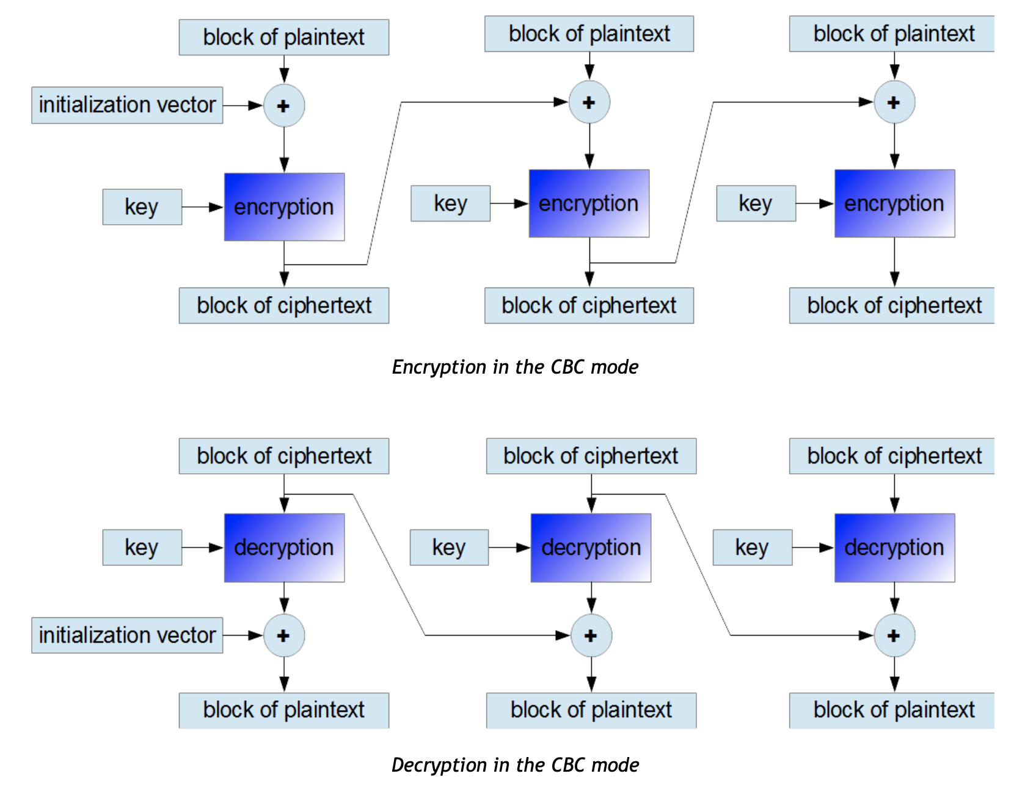
Cipher Block Chaining (CBC)
Notes:
In the cipher block chaining (CBC) mode (Figure 20.6), the input to the encryption algorithm is the XOR of the current plaintext block and the preceding ciphertext block; the same key is used for each block. In effect, we have chained together the processing of the sequence of plaintext blocks. The input to the encryption function for each plaintext block bears no fixed relationship to the plaintext block. Therefore, repeating patterns of b bits are not exposed. CBC is widely used in security applications.
For decryption, each cipher block is passed through the decryption algorithm. The result is XORed with the preceding ciphertext block to produce the plaintext block. To see that this works, we can write:
C_{j} = E(K, [C_{j–1} ⊕ P_{j}])
where E[K, X] is the encryption of plaintext X using key K, and ⊕ is the exclusive-OR operation.
To produce the first block of ciphertext, an initialization vector (IV) is XORed with the first block of plaintext. On decryption, the IV is XORed with the output of the decryption algorithm to recover the first block of plaintext.
The IV must be known to both the sender and receiver. For maximum security, the IV should be protected as well as the key. This could be done by sending the IV using ECB encryption. One reason for protecting the IV is as follows: If an opponent is able to fool the receiver into using a different value for IV, then the opponent is able to invert selected bits in the first block of plaintext.

Slide 44
CBC Analysis
Security: the CBC mode is secure, repeated plaintext will not be seen in repeated ciphertext.
Reoccurrences of key: the same key are used for all encryption and decryption blocks.
Speed:
Encryption: Each ciphertext block depends on the previous one. Thus, encryption in CBC mode can only be performed by using one thread.
Decryption: Because the receiver knows all the ciphertext blocks just after obtaining the encrypted message, he can decrypt the message using many threads simultaneously.

Slide 45
CBC Analysis
Effect of an error:
Encryption: If one bit of a plaintext message is damaged (for example because of some earlier transmission error), all subsequent ciphertext blocks will be damaged and it will be never possible to decrypt the ciphertext received from this plaintext.
Decryption: If one ciphertext bit is damaged, only two received plaintext blocks will be damaged. It might be possible to recover the data.

Slide 46
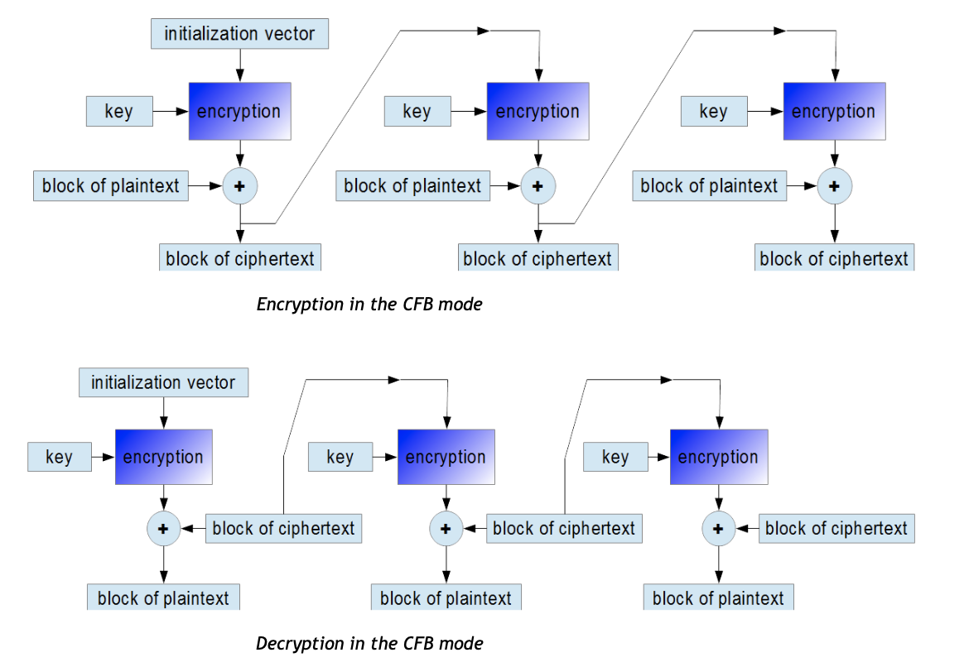
Cipher Feedback (CFB)
Notes:
It is possible to convert any block cipher into a stream cipher by using the cipher feedback (CFB) mode. A stream cipher eliminates the need to pad a message to be an integral number of blocks. It also can operate in real time. Thus, if a character stream is being transmitted, each character can be encrypted and transmitted immediately using a character-oriented stream cipher. One desirable property of a stream cipher is that the ciphertext be of the same length as the plaintext.
Figure 20.7 depicts the CFB scheme. In the figure, it is assumed that the unit of transmission is s bits; a common value is s = 8. As with CBC, the units of plaintext are chained together.
For encryption, the input to the encryption function is a b-bit shift register that is initially set to some initialization vector (IV). The leftmost (most significant) s bits of the output of the encryption function are XORed with the first unit of plaintext P₁ to produce the first unit of ciphertext C₁, which is then transmitted. In addition, the contents of the shift register are shifted left by s bits and C₁ is placed in the rightmost (least significant) s bits of the shift register. This process continues until all plaintext units have been encrypted. Will have:
C₁ = P₁ ⊕ S_{s}[E(K, IV)]
For decryption, the same scheme is used, except that the received ciphertext unit is XORed with the output of the encryption function to produce the plaintext unit. Note that it is the encryption function that is used, not the decryption function. This is easily explained. Let S_{s}(X) be defined as the most significant s bits of X. Then have
P₁ = C₁ ⊕ S_{s}[E(K, IV)]

Slide 47
CFB Analysis
Security: The CFB mode is similar to CBC. The main difference is that one should encrypt ciphertext data from the previous round and then add the output to the plaintext bits. It does not affect the cipher security but it results in the fact that the same encryption algorithm should be used during the decryption process.

Slide 48
CFB Analysis
Reoccurrences of key: the same key are used for all encryption and decryption blocks.
Speed:
Encryption: Encryption in CFB mode can be performed only by using one thread.
Decryption: As in CBC mode, one can decrypt ciphertext blocks using many threads simultaneously.

Slide 49
CFB Analysis
Effect of an error:
Encryption: If one bit of a plaintext message is damaged, the corresponding ciphertext block and all subsequent ciphertext blocks will be damaged.
Decryption: If one ciphertext bit is damaged, only two received plaintext blocks will be damaged.

Slide 50
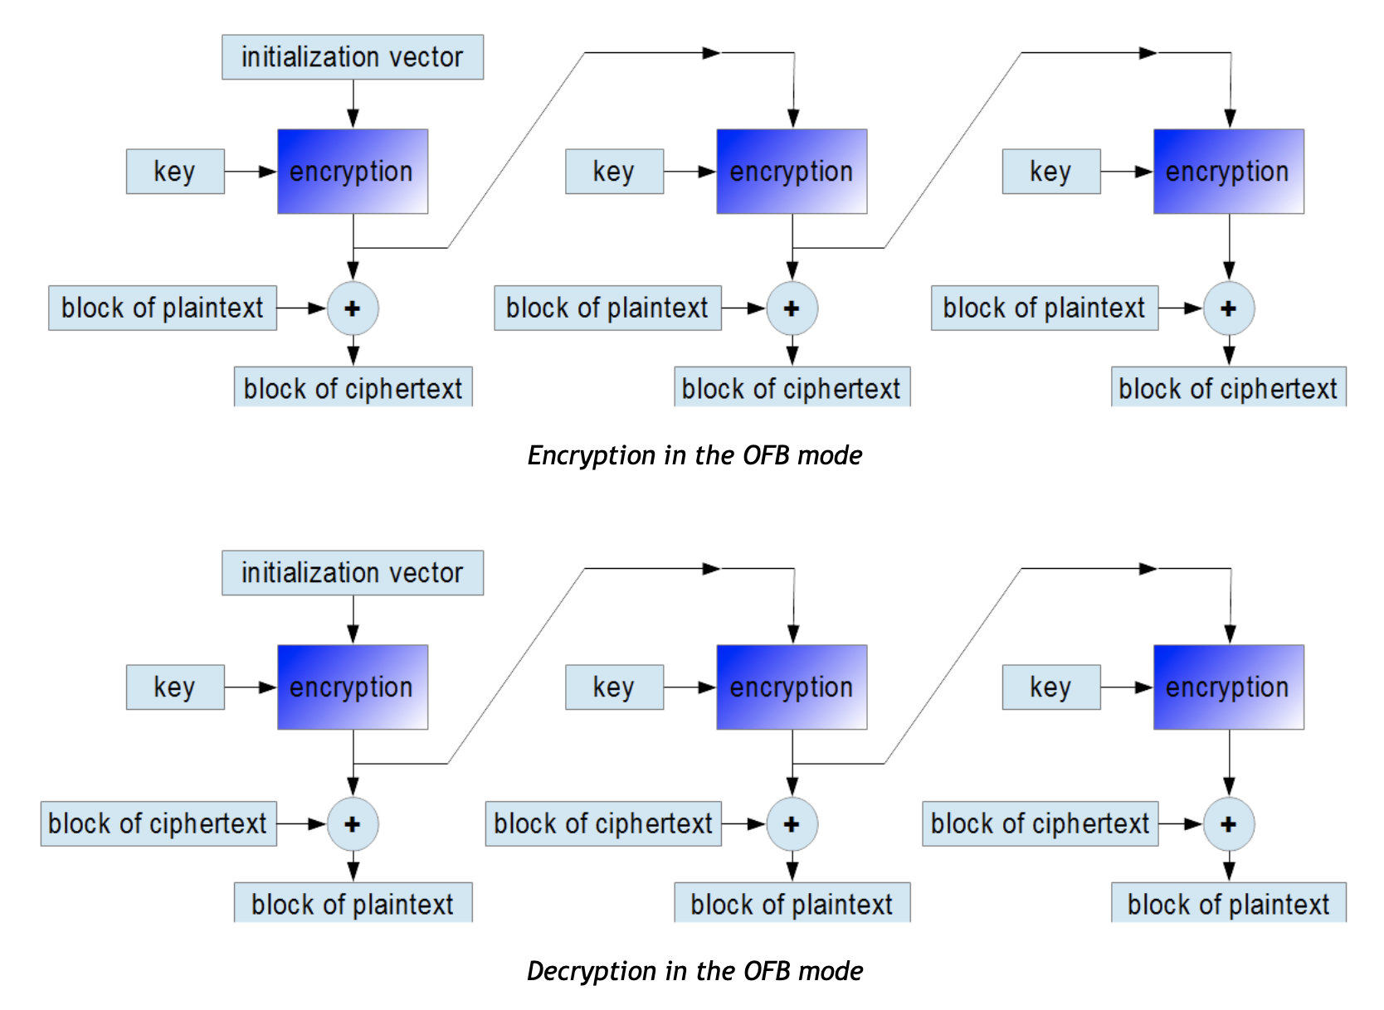
Output Feedback (OFB)

Slide 51
OFB Analysis
Security: The biggest drawback of OFB is that the repetition of encrypting the initialization vector may produce the same state that has occurred before. It is an unlikely situation but in such a case the plaintext will start to be encrypted by the same data as previously.
Reoccurrences of key: Algorithms that work in the OFB mode create keystream bits that are used for encryption subsequent data blocks. In this regard, the way of working of the block cipher becomes similar to the way of working of a typical stream cipher.

Slide 52
OFB Analysis
Speed: Because of the continuous creation of keystream bits, both encryption and decryption can be performed using only one thread at a time. Similarly, as in the CFB mode, both data encryption and decryption uses the same cipher encryption algorithm.
Effect of an error: If one bit of a plaintext or ciphertext message is damaged (for example because of a transmission error), only one corresponding ciphertext or respectively plaintext bit is damaged as well. It is possible to use various correction algorithms to restore the previous value of damaged parts of the received message.

Slide 53
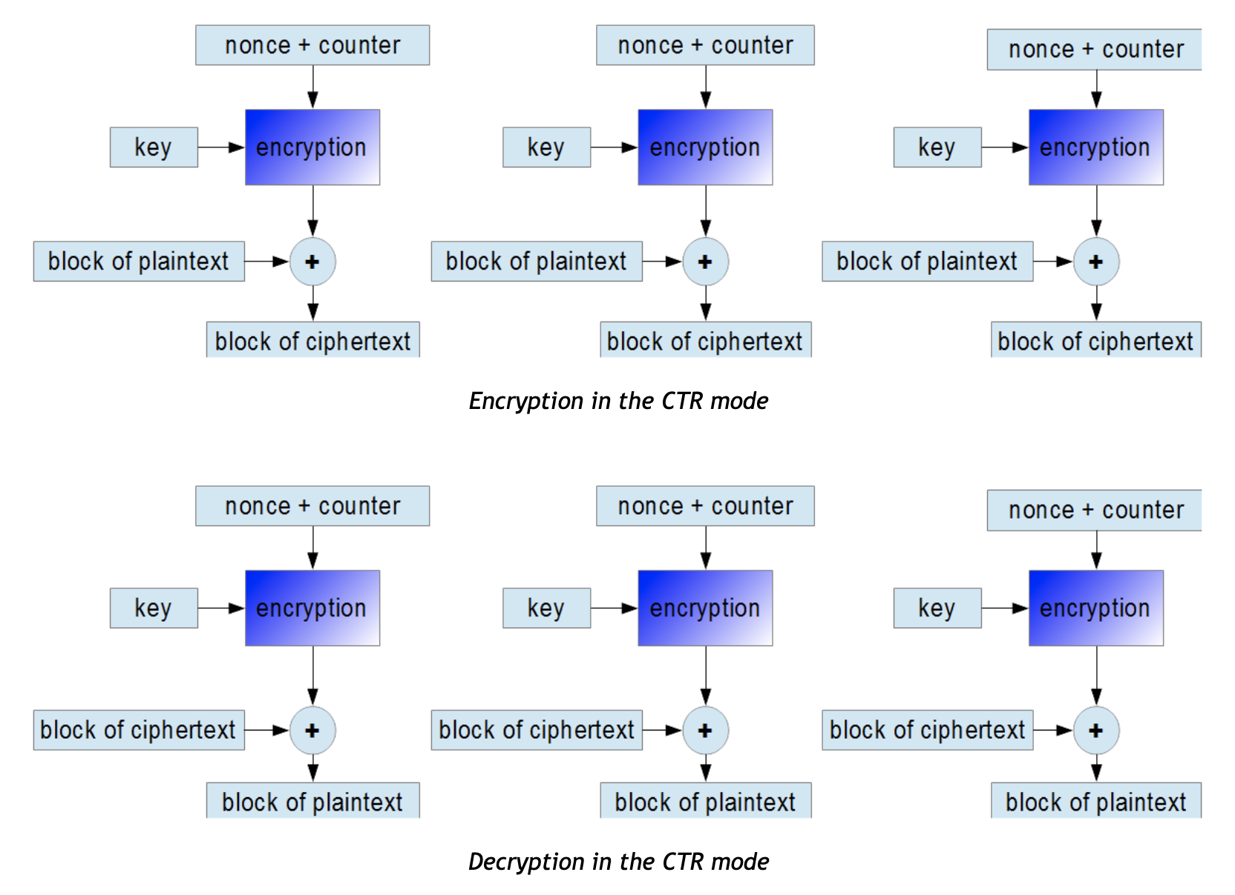
Counter (CTR)
Notes:
Although interest in the counter mode (CTR) has increased recently, with applications to ATM network security and IPSec), this mode was proposed early
Figure 20.8 depicts the CTR mode. A counter, equal to the plaintext block size is used. The only requirement stated in SP 800-38A is that the counter value must be different for each plaintext block that is encrypted. Typically, the counter is initialized to some value and then incremented by 1 for each subsequent block (modulo 2^{b}, where b is the block size). For encryption, the counter is encrypted and then XORed with the plaintext block to produce the ciphertext block; there is no chaining. For decryption, the same sequence of counter values is used, with each encrypted counter XORed with a ciphertext block to recover the corresponding plaintext block.
Some advantages of CTR mode are :
• Hardware efficiency: CTR mode can be done in parallel on multiple blocks of plaintext or ciphertext.
• Software efficiency: have opportunities for parallel execution in CTR mode.
• Preprocessing: can be used to prepare the output of the encryption boxes that feed into the XOR functions in Figure 20.8.
• Random access: The ith block of plaintext or ciphertext can be processed in random-access fashion.
• Provable security: CTR is at least as secure as the other mode.
• Simplicity: CTR mode oly needs the implementation of the encryption algorithm.

Slide 54
CTR Analysis
Security: In this mode, subsequent values of an increasing counter are added to a nonce value (the nonce means a number that is unique: number used once) and the results are encrypted as usual. The nonce plays the same role as initialization vectors.
Reoccurrences of key: Using the CTR mode makes block cipher way of working similar to a stream cipher. As in the OFB mode, keystream bits are created regardless of content of encrypting data blocks.

Slide 55
CTR Analysis
Speed: It is one of the most popular block ciphers modes of operation. Both encryption and decryption can be performed using many threads at the same time.
Effect of an error: If one bit of a plaintext or ciphertext message is damaged, only one corresponding output bit is damaged as well. Thus, it is possible to use various correction algorithms to restore the previous value of damaged parts of received messages.

Slide 56
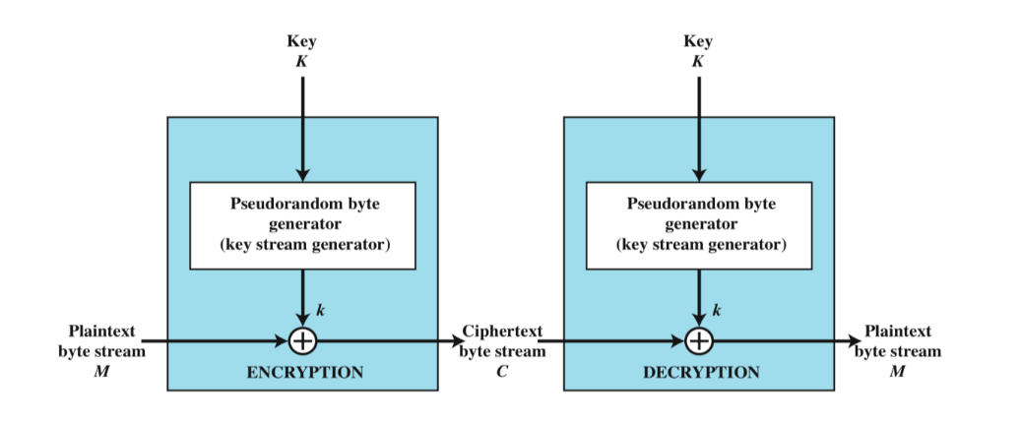
Stream Cipher Encryption – RC4
Encrypts plaintext one byte at a time (also other units)
Produces output one element at a time
Processes the input elements continuously
Notes:
Diagram of stream cipher structure. In this structure a key is input to a pseudorandom bit generator that produces a stream of 8-bit numbers that are apparently random. A pseudorandom stream is one that is unpredictable without knowledge of the input key and which has an apparently random character.
The output of the generator, called a keystream, is combined one byte at a time with the plaintext stream using the bitwise exclusive-OR (XOR) operation.

Slide 57
Stream Cipher Encryption – RC4
Almost always faster
Pseudorandom stream is one that is unpredictable without knowledge of the input key
Keys cannot be reused
Generate pseudo random keys (key Stream)
Notes:
Diagram of stream cipher structure. In this structure a key is input to a pseudorandom bit generator that produces a stream of 8-bit numbers that are apparently random. A pseudorandom stream is one that is unpredictable without knowledge of the input key and which has an apparently random character.
The output of the generator, called a keystream, is combined one byte at a time with the plaintext stream using the bitwise exclusive-OR (XOR) operation.

Slide 58
Message Confidentiality VS Message Authentication

Slide 59
Message Authentication
Protects against active attacks
Verifies that the received message is authentic
content have not been altered
from authentic source
timely and in correct sequence
can use conventional (Symmetric) encryption
Only sender and receiver share a key
Notes:
התקפה פאסיבית היא כזו של האזנה וציתות למסרים ומידע שמועבר.
כאן נרצה גם להגן מפני התקפות אקטיביות,
הרעיון הוא אימות הודעות ותכנים, המטרות לאמת ש:
המידע לא שונה בדרך
המידע הוא אכן מהמקור שאנחנו מצפים לקבל ממנו
המידע הגיע בזמן (ולא אחרי שנה) ובסדר הנכון
Encryption protects against passive attack (eavesdropping).
A different requirement is to protect against active attack (falsification of data and transactions).
Protection against such attacks is known as message or data authentication.
A message, file, document, or other collection of data is said to be authentic when it is genuine and came from its alleged source.
Message or data authentication is a procedure that allows communicating parties to verify that received or stored messages are authentic.
The two important aspects are to verify that the contents of the message have not been altered and that the source is authentic.
We may also wish to verify a message’s timeliness (it has not been artificially delayed and replayed) and sequence relative to other messages flowing between two parties. All of these concerns come under the category of data integrity.
It would seem possible to perform authentication simply by the use of symmetric encryption.
If we assume that only the sender and receiver share a key (which is as it should be), then only the genuine sender would be able to encrypt a message
successfully for the other participant, provided the receiver can recognize a valid message.
Furthermore, if the message includes an error-detection code and a sequence number, the receiver is assured that no alterations have been made and that sequencing is proper.
If the message also includes a timestamp, the receiver is assured that the message has not been delayed beyond that normally expected for network transit.
In fact, symmetric encryption alone is not a suitable tool for data authentication.
To give one simple example, in the ECB mode of encryption, if an attacker reorders the blocks of ciphertext, then each block will still decrypt successfully.
However, the reordering may alter the meaning of the overall data sequence.
Although sequence numbers may be used at some level (e.g., each IP packet), it is typically not the case that a separate sequence number will be associated with each b-bit block of plaintext. Thus, block reordering is a threat.

Slide 60
Message Authentication without Encryption
Symmetric Encryption only for message authentication is exposed to Block reorder attack (e.g in ECB)
Thus using a generated tag and appending it to each message protect from this attack as well:
Message Authentication Code
One Way Hash Function
Notes:
התקפה פאסיבית היא כזו של האזנה וציתות למסרים ומידע שמועבר.
כאן נרצה גם להגן מפני התקפות אקטיביות,
הרעיון הוא אימות הודעות ותכנים, המטרות לאמת ש:
המידע לא שונה בדרך
המידע הוא אכן מהמקור שאנחנו מצפים לקבל ממנו
המידע הגיע בזמן (ולא אחרי שנה) ובסדר הנכון
Encryption protects against passive attack (eavesdropping).
A different requirement is to protect against active attack (falsification of data and transactions).
Protection against such attacks is known as message or data authentication.
A message, file, document, or other collection of data is said to be authentic when it is genuine and came from its alleged source.
Message or data authentication is a procedure that allows communicating parties to verify that received or stored messages are authentic.
The two important aspects are to verify that the contents of the message have not been altered and that the source is authentic.
We may also wish to verify a message’s timeliness (it has not been artificially delayed and replayed) and sequence relative to other messages flowing between two parties. All of these concerns come under the category of data integrity.
It would seem possible to perform authentication simply by the use of symmetric encryption.
If we assume that only the sender and receiver share a key (which is as it should be), then only the genuine sender would be able to encrypt a message
successfully for the other participant, provided the receiver can recognize a valid message.
Furthermore, if the message includes an error-detection code and a sequence number, the receiver is assured that no alterations have been made and that sequencing is proper.
If the message also includes a timestamp, the receiver is assured that the message has not been delayed beyond that normally expected for network transit.
In fact, symmetric encryption alone is not a suitable tool for data authentication.
To give one simple example, in the ECB mode of encryption, if an attacker reorders the blocks of ciphertext, then each block will still decrypt successfully.
However, the reordering may alter the meaning of the overall data sequence.
Although sequence numbers may be used at some level (e.g., each IP packet), it is typically not the case that a separate sequence number will be associated with each b-bit block of plaintext. Thus, block reordering is a threat.

Slide 61
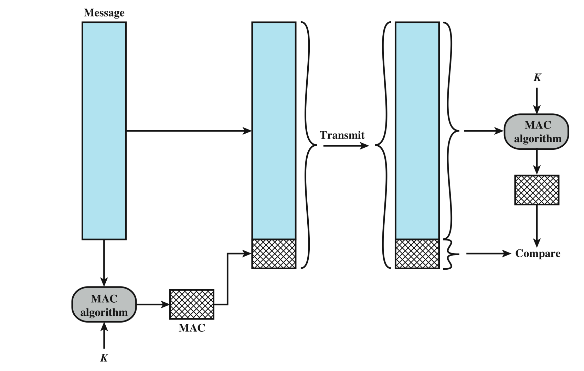
Message Authentication Codes (MAC)
MACM = F(KAB,M)
Notes:
למעשה היות והשולח והמקבל של המסרים המוצפנים חולקים את אותו מפתח סימטרי אזי ניתן להשתמש בסוד המשותף הזה גם כדי לאכוף אימות מסרים.
איך נעבוד כאן עם MAC?,
נקח את ההודעה ונפעיל עליה algorithm MAC עם המפתח ,
מצרפים להודעה את הMAC ומעבירים לצד השני ,
הצד השני צריך להשוות את הMAC שהוא יוצר לMAC שהגיע עם ההודעה ואם לא זהים אז יש בעיה בהודעה.
One authentication technique involves the use of a secret key to generate a small block of data, known as a message authentication code, that is appended to the message.
This technique assumes that two communicating parties, say A and B, share a common secret key KAB.
When A has a message to send to B, it calculates the message authentication code as a complex function of the message and the key: MACM F(KAB, M).
The message plus code are transmitted to the intended recipient.
The recipient performs the same calculation on the received message, using the same secret key, to generate a new message authentication code.
The received code is compared to the calculated code).
If we assume that only the receiver and the sender know the identity of the secret key, and if the received code matches the calculated code, then
1. The receiver is assured that the message has not been altered. If an attacker alters the message but does not alter the code, then the receiver’s calculation of the code will differ from the received code. Because the attacker is assumed not to know the secret key, the attacker cannot alter the code to correspond to the alterations in the message.
2. The receiver is assured that the message is from the alleged sender. Because no one else knows the secret key, no one else could prepare a message with a proper code.
3. If the message includes a sequence number (such as is used with X.25, HDLC, and TCP), then the receiver can be assured of the proper sequence, because an attacker cannot successfully alter the sequence number.
A number of algorithms could be used to generate the code. The NIST specification, FIPS PUB 113, recommends the use of DES. DES is used to generate an
encrypted version of the message, and the last number of bits of ciphertext are used as the code. A 16- or 32-bit code is typical.
The process just described is similar to encryption. One difference is that the authentication algorithm need not be reversible, as it must for decryption. It turns
out that because of the mathematical properties of the authentication function, it is less vulnerable to being broken than encryption.

Slide 62
Message Authentication Codes (MAC)
Only the sender and receiver share the secret key KAB
If the sender find a match between the received MAC and his calculated code then:
Message wasn’t altered: attacker can alter the message but not the code since doesn’t have the secret key
Sender authenticity –no one else is able to produce the same MAC due to the secret key
Message on correct order - attacker cannot alter the sequence number (X.25,HDLC, TCP) within a message
Note that MAC algorithms are not required to be reversible
Notes:
התקפה פאסיבית היא כזו של האזנה וציתות למסרים ומידע שמועבר.
כאן נרצה גם להגן מפני התקפות אקטיביות,
הרעיון הוא אימות הודעות ותכנים, המטרות לאמת ש:
המידע לא שונה בדרך
המידע הוא אכן מהמקור שאנחנו מצפים לקבל ממנו
המידע הגיע בזמן (ולא אחרי שנה) ובסדר הנכון
Encryption protects against passive attack (eavesdropping).
A different requirement is to protect against active attack (falsification of data and transactions).
Protection against such attacks is known as message or data authentication.
A message, file, document, or other collection of data is said to be authentic when it is genuine and came from its alleged source.
Message or data authentication is a procedure that allows communicating parties to verify that received or stored messages are authentic.
The two important aspects are to verify that the contents of the message have not been altered and that the source is authentic.
We may also wish to verify a message’s timeliness (it has not been artificially delayed and replayed) and sequence relative to other messages flowing between two parties. All of these concerns come under the category of data integrity.
It would seem possible to perform authentication simply by the use of symmetric encryption.
If we assume that only the sender and receiver share a key (which is as it should be), then only the genuine sender would be able to encrypt a message
successfully for the other participant, provided the receiver can recognize a valid message.
Furthermore, if the message includes an error-detection code and a sequence number, the receiver is assured that no alterations have been made and that sequencing is proper.
If the message also includes a timestamp, the receiver is assured that the message has not been delayed beyond that normally expected for network transit.
In fact, symmetric encryption alone is not a suitable tool for data authentication.
To give one simple example, in the ECB mode of encryption, if an attacker reorders the blocks of ciphertext, then each block will still decrypt successfully.
However, the reordering may alter the meaning of the overall data sequence.
Although sequence numbers may be used at some level (e.g., each IP packet), it is typically not the case that a separate sequence number will be associated with each b-bit block of plaintext. Thus, block reordering is a threat.

Slide 63
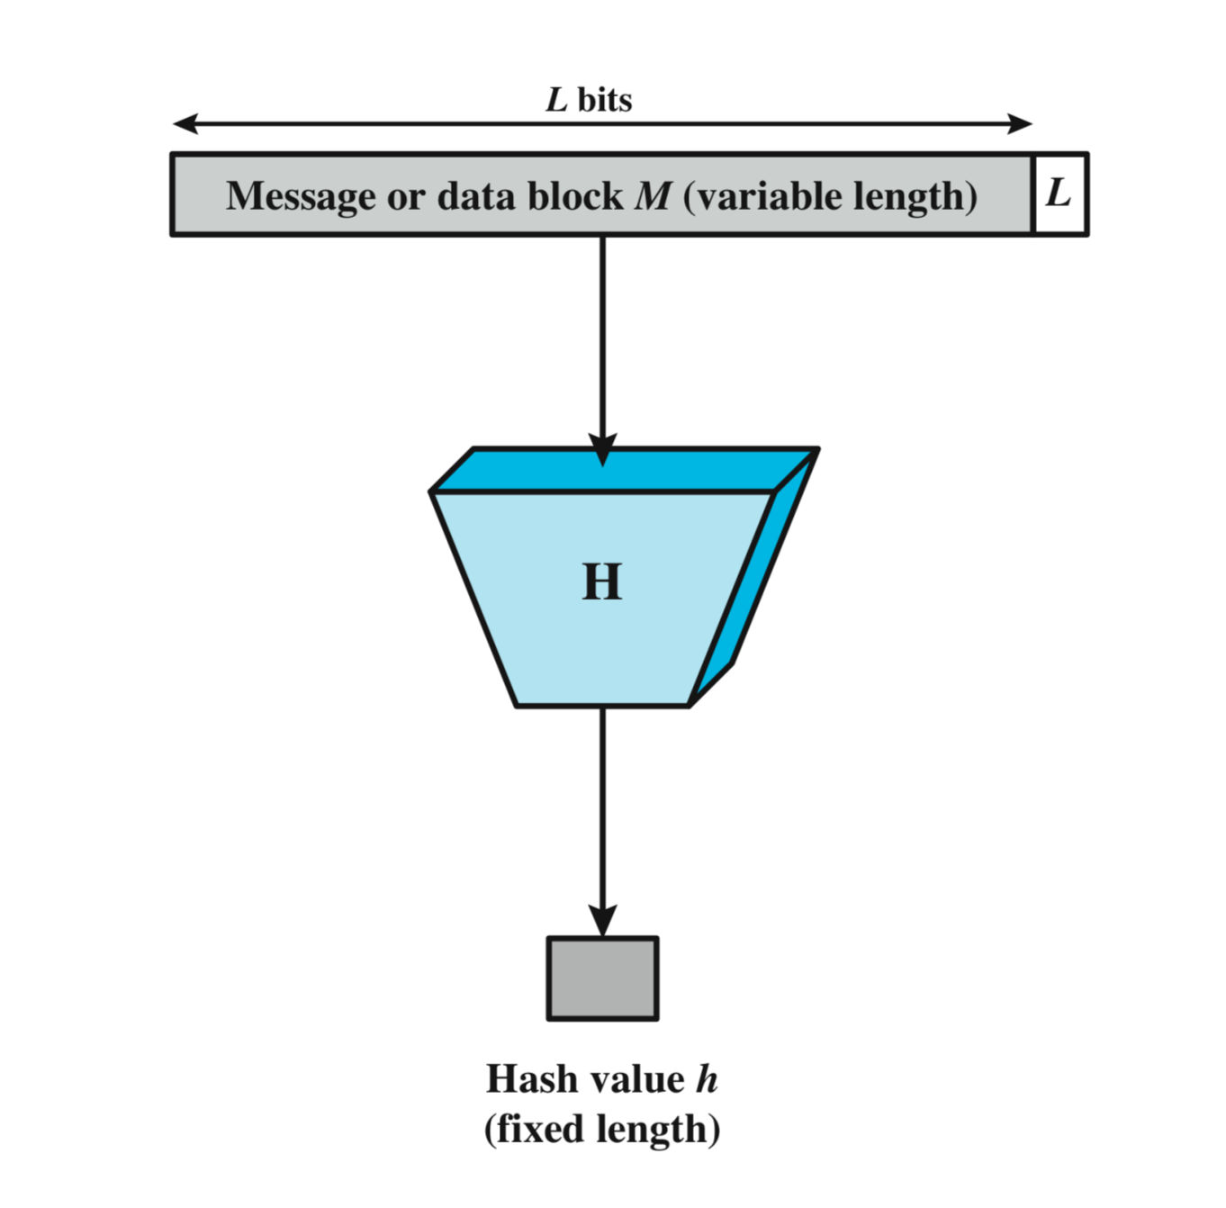
One-Way Hash Function
One way since it is not reversible
M message with variable length
H – one way hash function
H does not use a secret key
H(M) – fixed message digest that is added to the original message
We add to H(M) the length of the original message in bits
Hash is more lightweight than MAC
Sender authenticity is not guaranteed
Notes:
שיטה נוספת לאימות מסרים היא להשתמש בhash:
ניקח את ההודעה
נדרוש מhash שיעבוד על הודעה בכל אורך ,
מוסיפים תוספת שהיא אורך ההודעה ,
נפעיל פונקציית hash על ההודעה ,
מקבלים תוצאה שאותה מצרפים להודעה עצמה.
מה משיגים עם פונקצייה כזו? היא לא הפיתרון הכי טוב , התוקף יוכל לשנות את כל ההודעה כולל פונקציית הhash.
ב hashאין סוד שעובר, מניחים שכולם יודעים את פונקציית ההאש, ניתן להשתמש בו כדי לבדוק האם היו בעיות במהלך מעבר ההודעה.
An alternative to the message authentication code is the one-way hash function.
As with the message authentication code, a hash function accepts a variable-size message M as input and produces a fixed-size message digest
H(M) as output.
Typically, the message is padded out to an integer multiple of some fixed length (e.g., 1024 bits) and the padding includes the value of the length
of the original message in bits.
The length field is a security measure to increase the difficulty for an attacker to produce an alternative message with the same hash value.

Slide 64
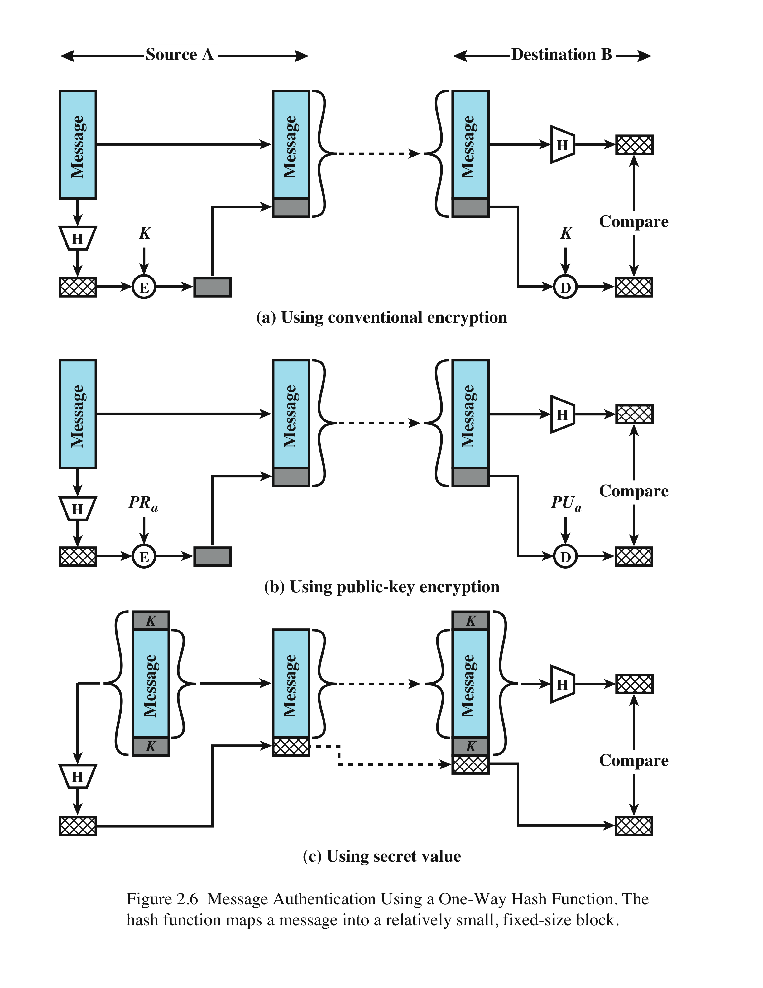
We encrypt the digest only using the symmetric key
Message Authentication Using a One-Way Hash Function – HMAC (MD2, MD4, MD5, SHA-1(160)/256/512) [53]
Notes:
Unlike the MAC, a hash function does not also take a secret key as input.
To authenticate a message, the message digest is sent with the message in such a way that the message digest is authentic.
The Figure illustrates three ways in which the message can be authenticated using a hash code.
The message digest can be encrypted using symmetric encryption (part a); if it is assumed that only the sender and receiver share the encryption key, then authenticity is assured.
The message digest can also be encrypted using public-key encryption (part b).
The public-key approach has two advantages: It provides a digital signature as well as message authentication; and it does not require the
distribution of keys to communicating parties.
These two approaches have an advantage over approaches that encrypt the entire message in that less computation is required. But an even more common approach is the use of a technique that avoids encryption altogether. Several reasons
for this interest are pointed out in [TSUD92]:
• Encryption software is quite slow. Even though the amount of data to be
encrypted per message is small, there may be a steady stream of messages into
and out of a system.
• Encryption hardware costs are non-negligible. Low-cost chip implementations
of DES are available, but the cost adds up if all nodes in a network must have
this capability.
• Encryption hardware is optimized toward large data sizes. For small blocks of
data, a high proportion of the time is spent in initialization/invocation overhead.
• An encryption algorithm may be protected by a patent.
Figure 2.6c shows a technique that uses a hash function but no encryption for message authentication.
This technique, known as a keyed hash MAC, assumes that two communicating parties, say A and B, share a common secret key K.
This secret key is incorporated into the process of generating a hash code. In the
approach illustrated in Figure 2.6c, when A has a message to send to B, it calculates
the hash function over the concatenation of the secret key and the message:
MDM = H(KMK).6 It then sends [ MMDM] to B. Because B possesses K, it can
recompute H(K7M7K) and verify MDM. Because the secret key itself is not sent, it
should not be possible for an attacker to modify an intercepted message. As long as
the secret key remains secret, it should not be possible for an attacker to generate a
false message.
Note that the secret key is used as both a prefix and a suffix to the message. If
the secret key is used as either only a prefix or only a suffix, the scheme is less secure.
This topic is discussed in Chapter 21. Chapter 21 also describes a scheme known
as HMAC, which is somewhat more complex than the approach of Figure 2.6c and
which has become the standard approach for a keyed hash MAC.

Slide 65
We encrypt the digest only using our private key - used as digital signature - no need for key distribution
Message Authentication Using a One-Way Hash Function – HMAC (MD2, MD4, MD5, SHA-1(160)/256/512) [53]
Notes:
Unlike the MAC, a hash function does not also take a secret key as input.
To authenticate a message, the message digest is sent with the message in such a way that the message digest is authentic.
The Figure illustrates three ways in which the message can be authenticated using a hash code.
The message digest can be encrypted using symmetric encryption (part a); if it is assumed that only the sender and receiver share the encryption key, then authenticity is assured.
The message digest can also be encrypted using public-key encryption (part b).
The public-key approach has two advantages: It provides a digital signature as well as message authentication; and it does not require the
distribution of keys to communicating parties.
These two approaches have an advantage over approaches that encrypt the entire message in that less computation is required. But an even more common approach is the use of a technique that avoids encryption altogether. Several reasons
for this interest are pointed out in [TSUD92]:
• Encryption software is quite slow. Even though the amount of data to be
encrypted per message is small, there may be a steady stream of messages into
and out of a system.
• Encryption hardware costs are non-negligible. Low-cost chip implementations
of DES are available, but the cost adds up if all nodes in a network must have
this capability.
• Encryption hardware is optimized toward large data sizes. For small blocks of
data, a high proportion of the time is spent in initialization/invocation overhead.
• An encryption algorithm may be protected by a patent.
Figure 2.6c shows a technique that uses a hash function but no encryption for message authentication.
This technique, known as a keyed hash MAC, assumes that two communicating parties, say A and B, share a common secret key K.
This secret key is incorporated into the process of generating a hash code. In the
approach illustrated in Figure 2.6c, when A has a message to send to B, it calculates
the hash function over the concatenation of the secret key and the message:
MDM = H(KMK).6 It then sends [ MMDM] to B. Because B possesses K, it can
recompute H(K7M7K) and verify MDM. Because the secret key itself is not sent, it
should not be possible for an attacker to modify an intercepted message. As long as
the secret key remains secret, it should not be possible for an attacker to generate a
false message.
Note that the secret key is used as both a prefix and a suffix to the message. If
the secret key is used as either only a prefix or only a suffix, the scheme is less secure.
This topic is discussed in Chapter 21. Chapter 21 also describes a scheme known
as HMAC, which is somewhat more complex than the approach of Figure 2.6c and
which has become the standard approach for a keyed hash MAC.

Slide 66
We use secret value K that is agreed on the sender and receiver, the secret is not sent therefore it is difficult for an attacker to create H(m)
Message Authentication Using a One-Way Hash Function – HMAC (MD2, MD4, MD5, SHA-1(160)/256/512) [53]
Notes:
Unlike the MAC, a hash function does not also take a secret key as input.
To authenticate a message, the message digest is sent with the message in such a way that the message digest is authentic.
The Figure illustrates three ways in which the message can be authenticated using a hash code.
The message digest can be encrypted using symmetric encryption (part a); if it is assumed that only the sender and receiver share the encryption key, then authenticity is assured.
The message digest can also be encrypted using public-key encryption (part b).
The public-key approach has two advantages: It provides a digital signature as well as message authentication; and it does not require the
distribution of keys to communicating parties.
These two approaches have an advantage over approaches that encrypt the entire message in that less computation is required. But an even more common approach is the use of a technique that avoids encryption altogether. Several reasons
for this interest are pointed out in [TSUD92]:
• Encryption software is quite slow. Even though the amount of data to be
encrypted per message is small, there may be a steady stream of messages into
and out of a system.
• Encryption hardware costs are non-negligible. Low-cost chip implementations
of DES are available, but the cost adds up if all nodes in a network must have
this capability.
• Encryption hardware is optimized toward large data sizes. For small blocks of
data, a high proportion of the time is spent in initialization/invocation overhead.
• An encryption algorithm may be protected by a patent.
Figure 2.6c shows a technique that uses a hash function but no encryption for message authentication.
This technique, known as a keyed hash MAC, assumes that two communicating parties, say A and B, share a common secret key K.
This secret key is incorporated into the process of generating a hash code. In the
approach illustrated in Figure 2.6c, when A has a message to send to B, it calculates
the hash function over the concatenation of the secret key and the message:
MDM = H(KMK).6 It then sends [ MMDM] to B. Because B possesses K, it can
recompute H(K7M7K) and verify MDM. Because the secret key itself is not sent, it
should not be possible for an attacker to modify an intercepted message. As long as
the secret key remains secret, it should not be possible for an attacker to generate a
false message.
Note that the secret key is used as both a prefix and a suffix to the message. If
the secret key is used as either only a prefix or only a suffix, the scheme is less secure.
This topic is discussed in Chapter 21. Chapter 21 also describes a scheme known
as HMAC, which is somewhat more complex than the approach of Figure 2.6c and
which has become the standard approach for a keyed hash MAC.

Slide 67
Hash Function Requirements
Can be applied to a block of data of any size
Produces a fixed-length output
H(x) is relatively easy to compute for any given x
One-way or pre-image resistant
computationally infeasible to find x such that H(x) = h
Notes:
The purpose of a hash function is to produce a
“fingerprint” of a file, message, or other block of data. To be useful for message
authentication, a hash function H must have the following properties:
1. H can be applied to a block of data of any size.
2. H produces a fixed-length output.
3. H(x) is relatively easy to compute for any given x, making both hardware and
software implementations practical.
4. For any given code h, it is computationally infeasible to find x such that
H(x) h. A hash function with this property is referred to as one-way or preimage
resistant.
5. For any given block x, it is computationally infeasible to find y x with
H(y) H(x). A hash function with this property is referred to as second preimage
resistant. This is sometimes referred to as weak collision resistant.
6. It is computationally infeasible to find any pair (x, y) such that H(x) H(y).
A hash function with this property is referred to as collision resistant. This is
sometimes referred to as strong collision resistant.
The first three properties are requirements for the practical application of a hash
function to message authentication.
The fourth property is the one-way property: It is easy to generate a code given a
message, but virtually impossible to generate a message given a code. This property is
important if the authentication technique involves the use of a secret value (Figure 2.6c).
The secret value itself is not sent; however, if the hash function is not one way, an attacker
can easily discover the secret value: If the attacker can observe or intercept a transmission,
the attacker obtains the message M and the hash code MDM H(SAB || M). The attacker
then inverts the hash function to obtain SAB || M H-1(MDM). Because the attacker now
has both M and SAB || M, it is a trivial matter to recover SAB.
The fifth property guarantees that it is impossible to find an alternative
message with the same hash value as a given message. This prevents forgery when
an encrypted hash code is used (Figures 2.6a and b). If this property were not true,
an attacker would be capable of the following sequence: First, observe or intercept
a message plus its encrypted hash code; second, generate an unencrypted hash code
from the message; third, generate an alternate message with the same hash code.
A hash function that satisfies the first five properties in the preceding list is
referred to as a weak hash function. If the sixth property is also satisfied, then it
is referred to as a strong hash function. A strong hash function protects against an
attack in which one party generates a message for another party to sign. For example,
suppose Bob gets to write an IOU message, send it to Alice, and she signs it.
Bob finds two messages with the same hash, one of which requires Alice to pay a
small amount and one that requires a large payment. Alice signs the first message
and Bob is then able to claim that the second message is authentic.

Slide 68
Hash Function Requirements
Second pre-image resistant or weak collision resistant
Given x, it computationally infeasible to find y ≠ x such that H(y) = H(x)
Not alternative message can be found
Collision resistant or strong collision resistance (Strong Hash)
computationally infeasible to find any pair (x, y) such that H(x) = H(y)
Notes:
The purpose of a hash function is to produce a
“fingerprint” of a file, message, or other block of data. To be useful for message
authentication, a hash function H must have the following properties:
1. H can be applied to a block of data of any size.
2. H produces a fixed-length output.
3. H(x) is relatively easy to compute for any given x, making both hardware and
software implementations practical.
4. For any given code h, it is computationally infeasible to find x such that
H(x) h. A hash function with this property is referred to as one-way or preimage
resistant.
5. For any given block x, it is computationally infeasible to find y x with
H(y) H(x). A hash function with this property is referred to as second preimage
resistant. This is sometimes referred to as weak collision resistant.
6. It is computationally infeasible to find any pair (x, y) such that H(x) H(y).
A hash function with this property is referred to as collision resistant. This is
sometimes referred to as strong collision resistant.
The first three properties are requirements for the practical application of a hash
function to message authentication.
The fourth property is the one-way property: It is easy to generate a code given a
message, but virtually impossible to generate a message given a code. This property is
important if the authentication technique involves the use of a secret value (Figure 2.6c).
The secret value itself is not sent; however, if the hash function is not one way, an attacker
can easily discover the secret value: If the attacker can observe or intercept a transmission,
the attacker obtains the message M and the hash code MDM H(SAB || M). The attacker
then inverts the hash function to obtain SAB || M H-1(MDM). Because the attacker now
has both M and SAB || M, it is a trivial matter to recover SAB.
The fifth property guarantees that it is impossible to find an alternative
message with the same hash value as a given message. This prevents forgery when
an encrypted hash code is used (Figures 2.6a and b). If this property were not true,
an attacker would be capable of the following sequence: First, observe or intercept
a message plus its encrypted hash code; second, generate an unencrypted hash code
from the message; third, generate an alternate message with the same hash code.
A hash function that satisfies the first five properties in the preceding list is
referred to as a weak hash function. If the sixth property is also satisfied, then it
is referred to as a strong hash function. A strong hash function protects against an
attack in which one party generates a message for another party to sign. For example,
suppose Bob gets to write an IOU message, send it to Alice, and she signs it.
Bob finds two messages with the same hash, one of which requires Alice to pay a
small amount and one that requires a large payment. Alice signs the first message
and Bob is then able to claim that the second message is authentic.

Slide 69
Security of Hash Functions
Two approaches to attacking a secure hash function:
Cryptanalysis
exploit logical weaknesses in the algorithm
Brute-force attack
strength of hash function depends solely on the length of the hash code produced by the algorithm
SHA (Secure hash function) most widely used hash algorithm – 160 bits
Notes:
As with symmetric encryption, there are two
approaches to attacking a secure hash function: cryptanalysis and brute-force attack.
As with symmetric encryption algorithms, cryptanalysis of a hash function involves
exploiting logical weaknesses in the algorithm.
The strength of a hash function against brute-force attacks depends solely on
the length of the hash code produced by the algorithm.
For a hash code of length n,
the level of effort required is proportional to the following:
Preimage resistant 2n
Second preimage resistant 2n
Collision resistant 2n/2
If collision resistance is required (and this is desirable for a general-purpose
secure hash code), then the value 2n/2 determines the strength of the hash code against
brute-force attacks. Van Oorschot and Wiener [VANO94] pre sented a design for a
$10 million collision search machine for MD5, which has a 128-bit hash length, that
could find a collision in 24 days. Thus a 128-bit code may be viewed as inadequate.
The next step up, if a hash code is treated as a sequence of 32 bits, is a 160-bit hash
length. With a hash length of 160 bits, the same search machine would require over
four thousand years to find a collision. With today’s technology, the time would be
much shorter, so that 160 bits now appears suspect.
In recent years, the most widely used
hash function has been the Secure Hash Algorithm (SHA). SHA was developed
by the National Institute of Standards and Technology (NIST) and published as
a federal information processing standard (FIPS 180) in 1993. When weaknesses
were discovered in SHA, a revised version was issued as FIPS 180-1 in 1995 and is
generally referred to as SHA-1. SHA-1 produces a hash value of 160 bits. In 2002,
NIST produced a revised version of the standard, FIPS 180–2, that defined three
new versions of SHA, with hash value lengths of 256, 384, and 512 bits, known as
SHA-256, SHA-384, and SHA-512. These new versions have the same underlying
structure and use the same types of modular arithmetic and logical binary operations
as SHA-1. In 2005, NIST announced the intention to phase out approval of SHA-1
and move to a reliance on the other SHA versions by 2010. As discussed in Chapter
21, researchers have demonstrated that SHA-1 is far weaker than its 160-bit hash
length suggests, necessitating the move to the newer versions of SHA.
We have discussed the use of hash functions for message authentication and for the
creation of digital signatures (the latter is discussed in more detail later in this chapter).
Here are two other examples of secure hash function applications:
• Passwords: Chapter 3 explains a scheme in which a hash of a password is
stored by an operating system rather than the password itself. Thus, the actual
password is not retrievable by a hacker who gains access to the password file.
In simple terms, when a user enters a password, the hash of that password is
compared to the stored hash value for verification. This application requires
preimage resistance and perhaps second preimage resistance.
• Intrusion detection: Store H(F) for each file on a system and secure the hash
values (e.g., on a CD-R that is kept secure). One can later determine if a file has
been modified by recomputing H(F). An intruder would need to change F without
changing H(F). This application requires weak second preimage resistance

Slide 70
Security of Hash Functions
Additional secure hash function applications:
Passwords - hash of a password is stored by an operating system
intrusion detection - store H(F) for each file on a system and secure the hash values
Notes:
As with symmetric encryption, there are two
approaches to attacking a secure hash function: cryptanalysis and brute-force attack.
As with symmetric encryption algorithms, cryptanalysis of a hash function involves
exploiting logical weaknesses in the algorithm.
The strength of a hash function against brute-force attacks depends solely on
the length of the hash code produced by the algorithm.
For a hash code of length n,
the level of effort required is proportional to the following:
Preimage resistant 2n
Second preimage resistant 2n
Collision resistant 2n/2
If collision resistance is required (and this is desirable for a general-purpose
secure hash code), then the value 2n/2 determines the strength of the hash code against
brute-force attacks. Van Oorschot and Wiener [VANO94] pre sented a design for a
$10 million collision search machine for MD5, which has a 128-bit hash length, that
could find a collision in 24 days. Thus a 128-bit code may be viewed as inadequate.
The next step up, if a hash code is treated as a sequence of 32 bits, is a 160-bit hash
length. With a hash length of 160 bits, the same search machine would require over
four thousand years to find a collision. With today’s technology, the time would be
much shorter, so that 160 bits now appears suspect.
In recent years, the most widely used
hash function has been the Secure Hash Algorithm (SHA). SHA was developed
by the National Institute of Standards and Technology (NIST) and published as
a federal information processing standard (FIPS 180) in 1993. When weaknesses
were discovered in SHA, a revised version was issued as FIPS 180-1 in 1995 and is
generally referred to as SHA-1. SHA-1 produces a hash value of 160 bits. In 2002,
NIST produced a revised version of the standard, FIPS 180–2, that defined three
new versions of SHA, with hash value lengths of 256, 384, and 512 bits, known as
SHA-256, SHA-384, and SHA-512. These new versions have the same underlying
structure and use the same types of modular arithmetic and logical binary operations
as SHA-1. In 2005, NIST announced the intention to phase out approval of SHA-1
and move to a reliance on the other SHA versions by 2010. As discussed in Chapter
21, researchers have demonstrated that SHA-1 is far weaker than its 160-bit hash
length suggests, necessitating the move to the newer versions of SHA.
We have discussed the use of hash functions for message authentication and for the
creation of digital signatures (the latter is discussed in more detail later in this chapter).
Here are two other examples of secure hash function applications:
• Passwords: Chapter 3 explains a scheme in which a hash of a password is
stored by an operating system rather than the password itself. Thus, the actual
password is not retrievable by a hacker who gains access to the password file.
In simple terms, when a user enters a password, the hash of that password is
compared to the stored hash value for verification. This application requires
preimage resistance and perhaps second preimage resistance.
• Intrusion detection: Store H(F) for each file on a system and secure the hash
values (e.g., on a CD-R that is kept secure). One can later determine if a file has
been modified by recomputing H(F). An intruder would need to change F without
changing H(F). This application requires weak second preimage resistance

Slide 71
Public-Key Encryption
Publicly proposed by Diffie and Hellman in 1976
Asymmetric
Uses two separate keys
Public key (PUK) and private key (PRK)
Public key is made public for others to use
There is a relation between the private and public key.
Some form of protocol is needed for distribution
Notes:
Public-key encryption, first publicly proposed by Diffie and Hellman in 1976
[DIFF76], is the first truly revolutionary advance in encryption in literally thousands
of years. Public-key algorithms are based on mathematical functions rather than on
simple operations on bit patterns, such as are used in symmetric encryption algorithms.
More important, public-key cryptography is asymmetric, involving the use
of two separate keys, in contrast to symmetric encryption, which uses only one key.
The use of two keys has profound consequences in the areas of confidentiality, key
distribution, and authentication.
Before proceeding, we should first mention several common misconceptions
concerning public-key encryption. One is that public-key encryption is more secure
from cryptanalysis than symmetric encryption. In fact, the security of any encryption
scheme depends on (1) the length of the key and (2) the computational work involved
in breaking a cipher. There is nothing in principle about either symmetric or public-key
encryption that makes one superior to another from the point of view of resisting cryptanalysis.
A second misconception is that public-key encryption is a general- purpose
technique that has made symmetric encryption obsolete. On the contrary, because of
the computational overhead of current public-key encryption schemes, there seems no
foreseeable likelihood that symmetric encryption will be abandoned. Finally, there is
a feeling that key distribution is trivial when using public-key encryption, compared to
the rather cumbersome handshaking involved with key distribution centers for symmetric
encryption. For public-key key distribution, some form of protocol is needed,
often involving a central agent, and the procedures involved are no simpler or any
more efficient than those required for symmetric encryption.
As the names suggest, the public key of the pair is made public for others to
use, while the private key is known only to its owner. A general-purpose public-key
cryptographic algorithm relies on one key for encryption and a different but related
key for decryption.
The essential steps are the following:
1. Each user generates a pair of keys to be used for the encryption and decryption
of messages.
2. Each user places one of the two keys in a public register or other accessible
file. This is the public key. The companion key is kept private. As Figure 2.7a
suggests, each user maintains a collection of public keys obtained from others.
3. If Bob wishes to send a private message to Alice, Bob encrypts the message
using Alice’s public key.
4. When Alice receives the message, she decrypts it using her private key. No
other recipient can decrypt the message because only Alice knows Alice’s private
key.
With this approach, all participants have access to public keys, and private keys
are generated locally by each participant and therefore need never be distributed.
As long as a user protects his or her private key, incoming communication is secure.
At any time, a user can change the private key and publish the companion public
key to replace the old public key.

Slide 72
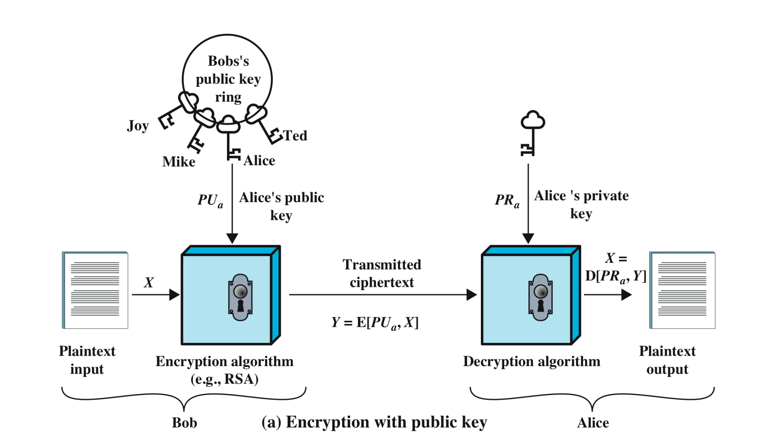
Public-Key Encryption [58] (Confidentiality)
Notes:
A public-key encryption scheme has six ingredients (Figure 2.7a):
• Plaintext: This is the readable message or data that is fed into the algorithm as
input.
• Encryption algorithm: The encryption algorithm performs various transformations
on the plaintext.
• Public and private key: This is a pair of keys that have been selected so that
if one is used for encryption, the other is used for decryption. The exact
transformations performed by the encryption algorithm depend on the public
or private key that is provided as input.
Ciphertext: This is the scrambled message produced as output. It depends on
the plaintext and the key. For a given message, two different keys will produce
two different ciphertexts.
• Decryption algorithm: This algorithm accepts the ciphertext and the matching
key and produces the original plaintext.
As the names suggest, the public key of the pair is made public for others to
use, while the private key is known only to its owner. A general-purpose public-key
cryptographic algorithm relies on one key for encryption and a different but related
key for decryption.
The essential steps are the following:
1. Each user generates a pair of keys to be used for the encryption and decryption
of messages.
2. Each user places one of the two keys in a public register or other accessible
file. This is the public key. The companion key is kept private. As Figure 2.7a
suggests, each user maintains a collection of public keys obtained from others.
3. If Bob wishes to send a private message to Alice, Bob encrypts the message
using Alice’s public key.
4. When Alice receives the message, she decrypts it using her private key. No
other recipient can decrypt the message because only Alice knows Alice’s private
key.
With this approach, all participants have access to public keys, and private keys
are generated locally by each participant and therefore need never be distributed.
As long as a user protects his or her private key, incoming communication is secure.
At any time, a user can change the private key and publish the companion public
key to replace the old public key.
Note that the scheme of Figure 2.7a is directed toward providing confidentiality:
Only the intended recipient should be able to decrypt the ciphertext because only
the intended recipient is in possession of the required private key. Whether in fact
confidentiality is provided depends on a number of factors, including the security of
the algorithm, whether the private key is kept secure, and the security of any protocol
of which the encryption function is a part.

Slide 73
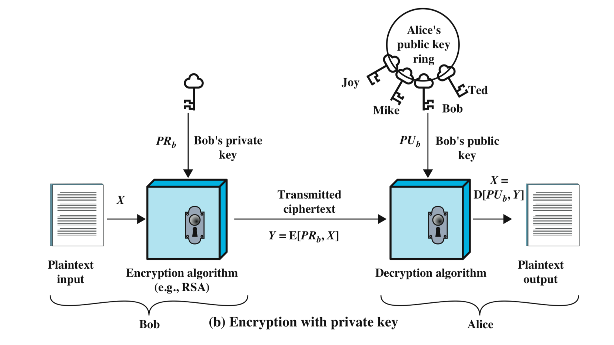
Private-Key Encryption (Authentication \ data integrity)
Notes:
Figure 2.7b illustrates another mode of operation of public-key cryptography.
In this scheme, a user encrypts data using his or her own private key.
Anyone who knows the corresponding public key will then be able to decrypt the
message.
The scheme of Figure 2.7b is directed toward providing authentication
and/or data integrity. If a user is able to successfully recover the plaintext from
Bob’s ciphertext using Bob’s public key, this indicates that only Bob could have
encrypted the plaintext, thus providing authentication. Further, no one but
Bob would be able to modify the plaintext because only Bob could encrypt the
plaintext with Bob’s private key. Once again, the actual provision of authentication
or data integrity depends on a variety of factors. This issue is addressed
primarily in Chapter 21, but other references are made to it where appropriate in
this text.

Slide 74
Requirements for Public-Key Cryptosystems
Computationally easy to create key pairs
Computationally easy for sender knowing public key to encrypt messages
Computationally easy for receiver knowing private key to decrypt ciphertext
Notes:
1. It is computationally easy for a party B to generate a pair (public key PUb, private key PRb).
2. It is computationally easy for a sender A, knowing the public key and the message to be encrypted, M, to generate the corresponding ciphertext: C = E(PUb, M)
3. It is computationally easy for the receiver B to decrypt the resulting ciphertext using the private key to recover the original message:
M = D(PRb,C) = D[PRb, E(PUb, M)]
4. It is computationally infeasible for an opponent, knowing the public key, PUb, to determine the private key, PRb.
5. It is computationally infeasible for an opponent, knowing the public key, PUb, and a ciphertext, C, to recover the original message, M.
We can add a sixth requirement that, although useful, is not necessary for all public-key applications:
6. Either of the two related keys can be used for encryption, with the other used for decryption.
M = D[PUb, E(PRb, M)] = D[PRb, E(PUb, M)]

Slide 75
Requirements for Public-Key Cryptosystems
Computationally infeasible for opponent to determine private key from public key
Computationally infeasible for opponent to otherwise recover original message
Useful if either key can be used for each role (encryption/Decryption)
Notes:
1. It is computationally easy for a party B to generate a pair (public key PUb, private key PRb).
2. It is computationally easy for a sender A, knowing the public key and the message to be encrypted, M, to generate the corresponding ciphertext: C = E(PUb, M)
3. It is computationally easy for the receiver B to decrypt the resulting ciphertext using the private key to recover the original message:
M = D(PRb,C) = D[PRb, E(PUb, M)]
4. It is computationally infeasible for an opponent, knowing the public key, PUb, to determine the private key, PRb.
5. It is computationally infeasible for an opponent, knowing the public key, PUb, and a ciphertext, C, to recover the original message, M.
We can add a sixth requirement that, although useful, is not necessary for all public-key applications:
6. Either of the two related keys can be used for encryption, with the other used for decryption.
M = D[PUb, E(PRb, M)] = D[PRb, E(PUb, M)]

Slide 76
Asymmetric Encryption Algorithms
RSA (Rivest, Shamir, Adleman)
developed in 1977
most widely accepted and implemented approach to public-key encryption
block cipher in which the plaintext and ciphertext are integers between [0 ,n-1] for some n
Diffie-Hellman key exchange algorithm
enables two users to securely reach agreement about a shared secret that can be used as a secret key for subsequent symmetric encryption of messages
limited to the exchange of the keys (handshake)
Digital Signature Standard (DSS)
provides only a digital signature function with SHA-1
cannot be used for encryption or key exchange
Elliptic curve cryptography (ECC)
security like RSA, but with much smaller keys – thus faster
Not useful for full message encryption
developed in 1991
Was broken when key was 428 bits, currently 1024 is considered strong enough
Used in e-commerce sites since they conduct very large number of transactions
Notes:
RSA One of the first public-key schemes was developed in 1977 by Ron Rivest, Adi
Shamir, and Len Adleman at MIT and first published in 1978 [RIVE78]. The RSA
scheme has since reigned supreme as the most widely accepted and implemented
approach to public-key encryption. RSA is a block cipher in which the plaintext and
ciphertext are integers between 0 and n – 1 for some n.
In 1977, the three inventors of RSA dared Scientific American readers to decode
a cipher they printed in Martin Gardner’s “Mathematical Games” column. They
offered a $100 reward for the return of a plaintext sentence, an event they predicted
might not occur for some 40 quadrillion years. In April of 1994, a group working over
the Internet and using over 1600 computers claimed the prize after only eight months
of work [LEUT94]. This challenge used a public-key size (length of n) of 129 decimal
digits, or around 428 bits. This result does not invalidate the use of RSA; it simply
means that larger key sizes must be used. Cur rently, a 1024-bit key size (about 300
decimal digits) is considered strong enough for virtually all applications.
DIFFIE-HELLMAN KEY AGREEMENT The first published public-key algo rithm
appeared in the seminal paper by Diffie and Hellman that defined public-key
cryptography [DIFF76] and is generally referred to as Diffie-Hellman key exchange,
or key agreement. A number of commercial products employ this key exchange
technique.
The purpose of the algorithm is to enable two users to securely reach agreement
about a shared secret that can be used as a secret key for subsequent symmetric
encryption of messages. The algorithm itself is limited to the exchange of the keys.
DIGITAL SIGNATURE STANDARD The National Institute of Standards and Technology
(NIST) has published Federal Information Processing Standard FIPS PUB 186,
known as the Digital Signature Standard (DSS). The DSS makes use of SHA-1
and presents a new digital signature technique, the Digital Signature Algorithm
(DSA). The DSS was originally proposed in 1991 and revised in 1993 in response to
public feedback concerning the security of the scheme. There was a further minor
revision in 1996. The DSS uses an algorithm that is designed to provide only the digital
signature function. Unlike RSA, it cannot be used for encryption or key exchange.
ELLIPTIC CURVE CRYPTOGRAPHY The vast majority of the products and standards
that use public-key cryptography for encryption and digital signatures use RSA.
The bit length for secure RSA use has increased over recent years, and this has put
a heavier processing load on applications using RSA. This burden has ramifications,
especially for electronic commerce sites that conduct large numbers of secure
transactions. Recently, a competing system has begun to challenge RSA: elliptic
curve cryptography (ECC). Already, ECC is showing up in standardization efforts,
including the IEEE (Institute of Electrical and Electronics Engineers) P1363
Standard for Public-Key Cryptography.
The principal attraction of ECC compared to RSA is that it appears to offer
equal security for a far smaller bit size, thereby reducing processing overhead. On
the other hand, although the theory of ECC has been around for some time, it is
only recently that products have begun to appear and that there has been sustained
cryptanalytic interest in probing for weaknesses. Thus, the confidence level in ECC
is not yet as high as that in RSA.

Slide 77
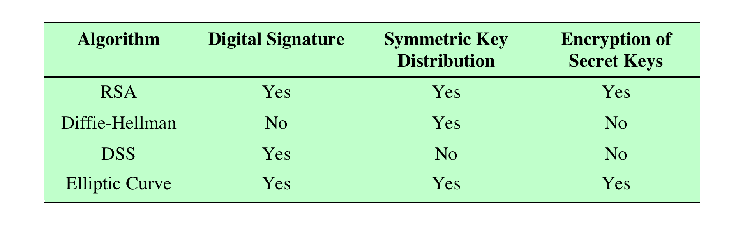
Applications for Public-Key Cryptosystems [59]
Notes:
Table 2.3 indicates the applications supported by the algorithms
discussed in this section.

Slide 78
Digital Signatures
Used for authenticating of:
Source
Data integrity
Created by encrypting hash code with private key
Does not provide confidentiality
Even in the case of complete encryption
Message is safe from alteration but not eavesdropping
Notes:
Public-key encryption can be used for authentication, as suggested by Figure 2.6b.
Suppose that Bob wants to send a message to Alice. Although it is not important that
the message be kept secret, he wants Alice to be certain that the message is indeed
from him. For this purpose, Bob uses a secure hash function, such as SHA-512, to
generate a hash value for the message and then encrypts the hash code with his private
key, creating a digital signature. Bob sends the message with the signature attached.
When Alice receives the message plus signature, she (1) calculates a hash value for
the message; (2) decrypts the signature using Bob’s public key; and (3) compares the
calculated hash value to the decrypted hash value. If the two hash values match, Alice
is assured that the message must have been signed by Bob. No one else has Bob’s
private key and therefore no one else could have created a ciphertext that could be
decrypted with Bob’s public key. In addition, it is impossible to alter the message
without access to Bob’s private key, so the message is authenticated both in terms of
source and in terms of data integrity.
It is important to emphasize that the digital signature does not provide confidentiality.
That is, the message being sent is safe from alteration but not safe from
eavesdropping. This is obvious in the case of a signature based on a portion of the
message, because the rest of the message is transmitted in the clear. Even in the
case of complete encryption, there is no protection of confidentiality because any
observer can decrypt the message by using the sender’s public key.

Slide 79
Digital Signatures
encrypt the digest only using private key - used as digital signature - no need for key distribution
Notes:
Unlike the MAC, a hash function does not also take a secret key as input.
To authenticate a message, the message digest is sent with the message in such a way that the message digest is authentic.
The Figure illustrates three ways in which the message can be authenticated using a hash code.
The message digest can be encrypted using symmetric encryption (part a); if it is assumed that only the sender and receiver share the encryption key, then authenticity is assured.
The message digest can also be encrypted using public-key encryption (part b).
The public-key approach has two advantages: It provides a digital signature as well as message authentication; and it does not require the
distribution of keys to communicating parties.
These two approaches have an advantage over approaches that encrypt the entire message in that less computation is required. But an even more common approach is the use of a technique that avoids encryption altogether. Several reasons
for this interest are pointed out in [TSUD92]:
• Encryption software is quite slow. Even though the amount of data to be
encrypted per message is small, there may be a steady stream of messages into
and out of a system.
• Encryption hardware costs are non-negligible. Low-cost chip implementations
of DES are available, but the cost adds up if all nodes in a network must have
this capability.
• Encryption hardware is optimized toward large data sizes. For small blocks of
data, a high proportion of the time is spent in initialization/invocation overhead.
• An encryption algorithm may be protected by a patent.
Figure 2.6c shows a technique that uses a hash function but no encryption for message authentication.
This technique, known as a keyed hash MAC, assumes that two communicating parties, say A and B, share a common secret key K.
This secret key is incorporated into the process of generating a hash code. In the
approach illustrated in Figure 2.6c, when A has a message to send to B, it calculates
the hash function over the concatenation of the secret key and the message:
MDM = H(KMK).6 It then sends [ MMDM] to B. Because B possesses K, it can
recompute H(K7M7K) and verify MDM. Because the secret key itself is not sent, it
should not be possible for an attacker to modify an intercepted message. As long as
the secret key remains secret, it should not be possible for an attacker to generate a
false message.
Note that the secret key is used as both a prefix and a suffix to the message. If
the secret key is used as either only a prefix or only a suffix, the scheme is less secure.
This topic is discussed in Chapter 21. Chapter 21 also describes a scheme known
as HMAC, which is somewhat more complex than the approach of Figure 2.6c and
which has become the standard approach for a keyed hash MAC.

Slide 80
Public Key Certificates
The weakness of PKE:
anyone can forge a publication of the Bob’s public key and
by the time it is discovered he can read messages aimed at Bob and pretend to be Bob as well
We need a trusted third party – certificate authority CA
Notes:
בוב הולך קודם לCA ומבקש שיספק לוcertificate , התקשורת היא קודם בין בוב לCA.
קיים צד שלשי , certificate authority, לכל אחד שמשתתף בתקשורת , המשתתף הולך לנציג הזה מזדהה בפניו , ומבקש ממנו certificate , שכל מי שרוצה לדבר איתי שכולם יוודאו שהוא בוב.
מה כולל הcertificate?
את הפרטים של בוב,
את המפתח שלו ואת הפרטים של ה certificate , אותו נציג ונצרף את הMAC , ומצמיד אותו להודעה( הריבוע השחור נקרא digital signature) . כדי לעשות ווידוא למפתח הפומבי של בוב , נעשה האש למפתח של בוב ושאר השדות שמעליו ומתחתיו , ונעשה פיענוח של החתימה ואם נקבל פרטים שונים כנראה שמי שמדבר איתנו הוא לא בוב.
On the face of it, the point of public-key encryption is that the public key is public.
Thus, if there is some broadly accepted public-key algorithm, such as RSA, any
participant can send his or her public key to any other participant or broadcast the
key to the community at large. Although this approach is convenient, it has a major
weakness. Anyone can forge such a public announcement. That is, some user could
pretend to be Bob and send a public key to another participant or broadcast such a
public key. Until such time as Bob discovers the forgery and alerts other participants,
the forger is able to read all encrypted messages intended for A and can use the
forged keys for authentication.
The solution to this problem is the public-key certificate. In essence, a certificate
consists of a public key plus a user ID of the key owner, with the whole block
signed by a trusted third party. The certificate also includes some information about
the third party plus an indication of the period of validity of the certificate. Typically,
the third party is a certificate authority (CA) that is trusted by the user community,
such as a government agency or a financial institution. A user can present his
or her public key to the authority in a secure manner and obtain a signed certificate.
The user can then publish the certificate. Anyone needing this user’s public key
can obtain the certificate and verify that it is valid by means of the attached trusted
signature. Figure 2.8 illustrates the process.
One scheme has become universally accepted for formatting public-key
certificates: the X.509 standard. X.509 certificates are used in most network security
applications, including IP Security (IPsec), Transport Layer Security (TLS), Secure
Shell (SSH), and Secure/Multipurpose Internet Mail Extension (S/MIME). We
examine most of these applications in Part Five.

Slide 81
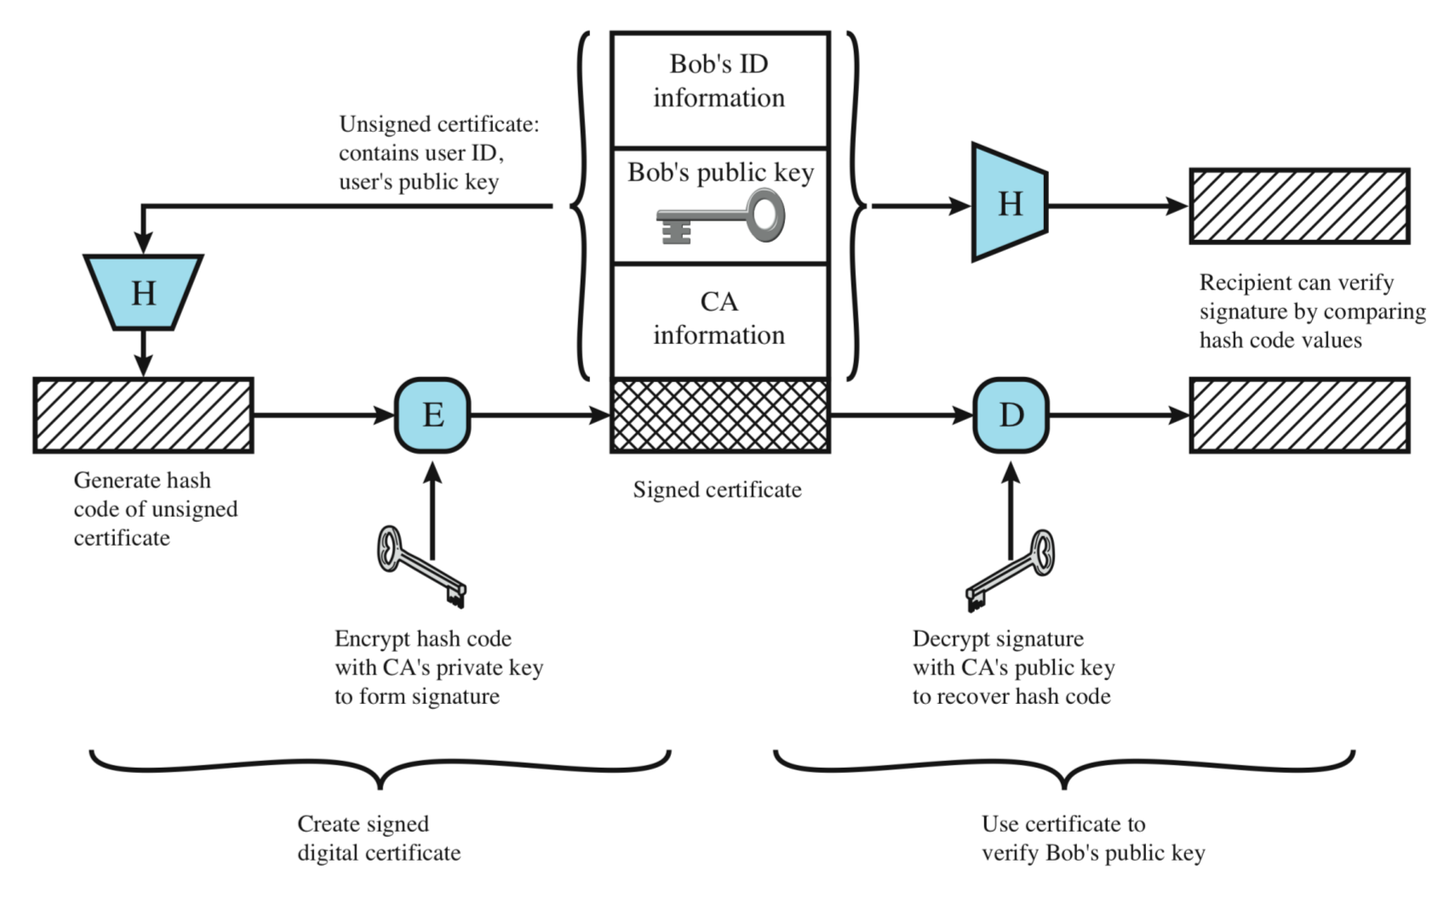
Public Key Certificates
Notes:
בוב הולך קודם לCA ומבקש שיספק לוcertificate , התקשורת היא קודם בין בוב לCA.
קיים צד שלשי , certificate authority, לכל אחד שמשתתף בתקשורת , המשתתף הולך לנציג הזה מזדהה בפניו , ומבקש ממנו certificate , שכל מי שרוצה לדבר איתי שכולם יוודאו שהוא בוב.
מה כולל הcertificate?
את הפרטים של בוב,
את המפתח שלו ואת הפרטים של ה certificate , אותו נציג ונצרף את הMAC , ומצמיד אותו להודעה( הריבוע השחור נקרא digital signature) . כדי לעשות ווידוא למפתח הפומבי של בוב , נעשה האש למפתח של בוב ושאר השדות שמעליו ומתחתיו , ונעשה פיענוח של החתימה ואם נקבל פרטים שונים כנראה שמי שמדבר איתנו הוא לא בוב.
On the face of it, the point of public-key encryption is that the public key is public.
Thus, if there is some broadly accepted public-key algorithm, such as RSA, any
participant can send his or her public key to any other participant or broadcast the
key to the community at large. Although this approach is convenient, it has a major
weakness. Anyone can forge such a public announcement. That is, some user could
pretend to be Bob and send a public key to another participant or broadcast such a
public key. Until such time as Bob discovers the forgery and alerts other participants,
the forger is able to read all encrypted messages intended for A and can use the
forged keys for authentication.
The solution to this problem is the public-key certificate. In essence, a certificate
consists of a public key plus a user ID of the key owner, with the whole block
signed by a trusted third party. The certificate also includes some information about
the third party plus an indication of the period of validity of the certificate. Typically,
the third party is a certificate authority (CA) that is trusted by the user community,
such as a government agency or a financial institution. A user can present his
or her public key to the authority in a secure manner and obtain a signed certificate.
The user can then publish the certificate. Anyone needing this user’s public key
can obtain the certificate and verify that it is valid by means of the attached trusted
signature. Figure 2.8 illustrates the process.
One scheme has become universally accepted for formatting public-key
certificates: the X.509 standard. X.509 certificates are used in most network security
applications, including IP Security (IPsec), Transport Layer Security (TLS), Secure
Shell (SSH), and Secure/Multipurpose Internet Mail Extension (S/MIME). We
examine most of these applications in Part Five.

Slide 82
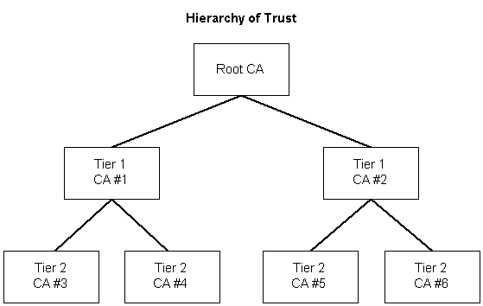
Public Key Certificates – hierarchy of trust
Notes:
בוב הולך קודם לCA ומבקש שיספק לוcertificate , התקשורת היא קודם בין בוב לCA.
קיים צד שלשי , certificate authority, לכל אחד שמשתתף בתקשורת , המשתתף הולך לנציג הזה מזדהה בפניו , ומבקש ממנו certificate , שכל מי שרוצה לדבר איתי שכולם יוודאו שהוא בוב.
מה כולל הcertificate?
את הפרטים של בוב,
את המפתח שלו ואת הפרטים של ה certificate , אותו נציג ונצרף את הMAC , ומצמיד אותו להודעה( הריבוע השחור נקרא digital signature) . כדי לעשות ווידוא למפתח הפומבי של בוב , נעשה האש למפתח של בוב ושאר השדות שמעליו ומתחתיו , ונעשה פיענוח של החתימה ואם נקבל פרטים שונים כנראה שמי שמדבר איתנו הוא לא בוב.
On the face of it, the point of public-key encryption is that the public key is public.
Thus, if there is some broadly accepted public-key algorithm, such as RSA, any
participant can send his or her public key to any other participant or broadcast the
key to the community at large. Although this approach is convenient, it has a major
weakness. Anyone can forge such a public announcement. That is, some user could
pretend to be Bob and send a public key to another participant or broadcast such a
public key. Until such time as Bob discovers the forgery and alerts other participants,
the forger is able to read all encrypted messages intended for A and can use the
forged keys for authentication.
The solution to this problem is the public-key certificate. In essence, a certificate
consists of a public key plus a user ID of the key owner, with the whole block
signed by a trusted third party. The certificate also includes some information about
the third party plus an indication of the period of validity of the certificate. Typically,
the third party is a certificate authority (CA) that is trusted by the user community,
such as a government agency or a financial institution. A user can present his
or her public key to the authority in a secure manner and obtain a signed certificate.
The user can then publish the certificate. Anyone needing this user’s public key
can obtain the certificate and verify that it is valid by means of the attached trusted
signature. Figure 2.8 illustrates the process.
One scheme has become universally accepted for formatting public-key
certificates: the X.509 standard. X.509 certificates are used in most network security
applications, including IP Security (IPsec), Transport Layer Security (TLS), Secure
Shell (SSH), and Secure/Multipurpose Internet Mail Extension (S/MIME). We
examine most of these applications in Part Five.

Slide 83
Digital Envelopes
Protects a message without needing to first arrange for sender and receiver to have the same secret key
Equates to the same thing as a sealed envelope containing an unsigned letter
The symmetric key is exchanges through Asymmetric PKE
The messages encrypted using the encrypted symmetric key
Advantages:
Short keys
Symmetric - Fast encryption and decryption of messages
New symmetric keys in every session – enhances confidentiality
Notes:
Another application in which public-key encryption is used to protect a symmetric
key is the digital envelope, which can be used to protect a message without needing
to first arrange for sender and receiver to have the same secret key. The technique
is referred to as a digital envelope, which is the equivalent of a sealed envelope
containing an unsigned letter. The general approach is shown in Figure 2.9. Suppose
Bob wishes to send a confidential message to Alice, but they do not share a symmetric
secret key. Bob does the following:
1. Prepare a message.
2. Generate a random symmetric key that will be used this one time only.
3. Encrypt that message using symmetric encryption the one-time key.
4. Encrypt the one-time key using public-key encryption with Alice’s public key.
5. Attach the encrypted one-time key to the encrypted message and send it to
Alice.
Only Alice is capable of decrypting the one-time key and therefore of recovering
the original message. If Bob obtained Alice’s public key by means of Alice’s
public-key certificate, then Bob is assured that it is a valid key.

Slide 84
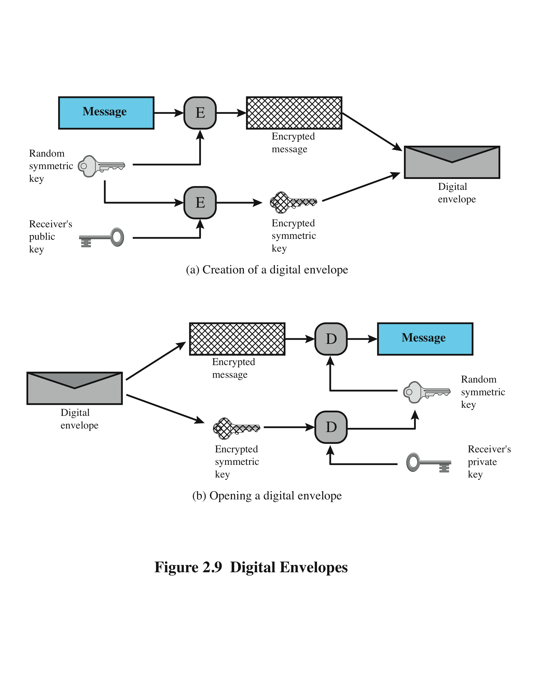
Digital Envelopes - Encryption
Notes:
Another application in which public-key encryption is used to protect a symmetric
key is the digital envelope, which can be used to protect a message without needing
to first arrange for sender and receiver to have the same secret key. The technique
is referred to as a digital envelope, which is the equivalent of a sealed envelope
containing an unsigned letter. The general approach is shown in Figure 2.9. Suppose
Bob wishes to send a confidential message to Alice, but they do not share a symmetric
secret key. Bob does the following:
1. Prepare a message.
2. Generate a random symmetric key that will be used this one time only.
3. Encrypt that message using symmetric encryption the one-time key.
4. Encrypt the one-time key using public-key encryption with Alice’s public key.
5. Attach the encrypted one-time key to the encrypted message and send it to
Alice.
Only Alice is capable of decrypting the one-time key and therefore of recovering
the original message. If Bob obtained Alice’s public key by means of Alice’s
public-key certificate, then Bob is assured that it is a valid key.

Slide 85
Digital Envelopes
Notes:
Another application in which public-key encryption is used to protect a symmetric
key is the digital envelope, which can be used to protect a message without needing
to first arrange for sender and receiver to have the same secret key. The technique
is referred to as a digital envelope, which is the equivalent of a sealed envelope
containing an unsigned letter. The general approach is shown in Figure 2.9. Suppose
Bob wishes to send a confidential message to Alice, but they do not share a symmetric
secret key. Bob does the following:
1. Prepare a message.
2. Generate a random symmetric key that will be used this one time only.
3. Encrypt that message using symmetric encryption the one-time key.
4. Encrypt the one-time key using public-key encryption with Alice’s public key.
5. Attach the encrypted one-time key to the encrypted message and send it to
Alice.
Only Alice is capable of decrypting the one-time key and therefore of recovering
the original message. If Bob obtained Alice’s public key by means of Alice’s
public-key certificate, then Bob is assured that it is a valid key.

Slide 86
Q&A
Bob encrypt a message with symmetric key, and sends it to Alice who owns this key as well, what did he achieve?
Bob encrypts a message with his private key, and sends it to Alice, what did he achieve?
Bob encrypts a message with his public key, and sends it to Alice, what did he achieve?
Bob encrypts message with Alice’s public key, and sends it to Alice, what did he achieve?
Bob encrypts message’s hash code with his private key, and sends it to Alice with the message itself encrypted with Alice’s public key, what did he achieve?
Bob encrypts message’s hash code with Alice’s public key, and sends it to Alice, what did he achieve?
Confidentiality?
Message authentication (integrity of content and time)?
Source authentication?
Nothing
Notes:
תשובות לשאלות:
a+c המידע מגיע מוגן, רק למי שאני חולק איתו את המפתח ולכן אני אליס יודעת שזה אני.
c - בלבד כי כולם יודעים את הציבורי שלי, ולכן אין כאן confidentiality.
d – כלום כי רק לי יש את הפרטי, אין לאף אחד מה לעשות עם זה..... ובטח שגם לא לי.
a - בלבד כי המידע אומנם מגיע מוגן, אבל כולם יכולים להצפין עם הציבורי של אליס ולכן לא ידוע מי שלח בתצורה הזו.
A + C + B
D – כלום כי רק אליס יכולה לפתוח את ה HASH ומה היא תעשה איתה בדיוק?
Another application in which public-key encryption is used to protect a symmetric
key is the digital envelope, which can be used to protect a message without needing
to first arrange for sender and receiver to have the same secret key. The technique
is referred to as a digital envelope, which is the equivalent of a sealed envelope
containing an unsigned letter. The general approach is shown in Figure 2.9. Suppose
Bob wishes to send a confidential message to Alice, but they do not share a symmetric
secret key. Bob does the following:
1. Prepare a message.
2. Generate a random symmetric key that will be used this one time only.
3. Encrypt that message using symmetric encryption the one-time key.
4. Encrypt the one-time key using public-key encryption with Alice’s public key.
5. Attach the encrypted one-time key to the encrypted message and send it to
Alice.
Only Alice is capable of decrypting the one-time key and therefore of recovering
the original message. If Bob obtained Alice’s public key by means of Alice’s
public-key certificate, then Bob is assured that it is a valid key.

Slide 87
Strength of algorithms
Key space
Strength of the algorithm
Correctness of implementation
Key management
Random number generator

Slide 88
Cryptanalysis
Breaking codes
Attack vectors
Key
Algorithm
Implementation
Data
Social engineering

Slide 89
Random Numbers
Keys for public-key algorithms
Stream key for symmetric stream cipher
Symmetric key to be used as a temporary session key or in creating a digital envelope
Handshaking to prevent replay attacks
Session key
Notes:
A number of network security algorithms based on cryptography make use of random numbers.
For example,
• Generation of keys for the RSA public-key encryption algorithm and other public-key algorithms.
• Generation of a stream key for symmetric stream cipher.
• Generation of a symmetric key for use as a temporary session key or in creating a digital envelope.
• In a number of key distribution scenarios, such as Kerberos, random numbers are used for handshaking to prevent replay attacks.
• Session key generation, whether done by a key distribution center or by one of the principals.
These applications give rise to two distinct and not necessarily compatible
requirements for a sequence of random numbers: randomness and unpredictability.

Slide 90
Random Number Requirements
Randomness
Uniform distribution
frequency of occurrence of each of the numbers should be approximately the same
Independence
no one value in the sequence can be inferred from the others
Unpredictability
Each number is statistically independent of other numbers in the sequence
Opponent should not be able to predict future elements of the sequence on the basis of earlier elements
Notes:
Traditionally, the concern in the generation of a sequence of
allegedly random numbers has been that the sequence of numbers be random in
some well-defined statistical sense. The following two criteria are used to validate
that a sequence of numbers is random:
• Uniform distribution: The distribution of numbers in the sequence should be
uniform; that is, the frequency of occurrence of each of the numbers should be
approximately the same.
• Independence: No one value in the sequence can be inferred from the others.
Although there are well-defined tests for determining that a sequence of numbers
matches a particular distribution, such as the uniform distribution, there is no such
test to “prove” independence. Rather, a number of tests can be applied to demonstrate
if a sequence does not exhibit independence. The general strategy is to apply a number
of such tests until the confidence that independence exists is sufficiently strong.
In the context of our discussion, the use of a sequence of numbers that appear
statistically random often occurs in the design of algorithms related to cryptography.
For example, a fundamental requirement of the RSA public-key encryption scheme
is the ability to generate prime numbers. In general, it is
difficult to determine if a given large number N is prime. A brute-force approach
would be to divide N by every odd integer less than 1N. If N is on the order, say,
of 10150, a not uncommon occurrence in public-key cryptography, such a brute-force
approach is beyond the reach of human analysts and their computers. However, a
number of effective algorithms exist that test the primality of a number by using a
sequence of randomly chosen integers as input to relatively simple computations.
If the sequence is sufficiently long (but far, far less than 110150), the primality of
a number can be determined with near certainty. This type of approach, known
as randomization, crops up frequently in the design of algorithms. In essence, if a
problem is too hard or time-consuming to solve exactly, a simpler, shorter approach
based on randomization is used to provide an answer with any desired level of
confidence.
UNPREDICTABILITY
In applications such as reciprocal authentication and session key
generation, the requirement is not so much that the sequence of numbers be statistically
random but that the successive members of the sequence are unpredictable. With
“true” random sequences, each number is statistically independent of other numbers
in the sequence and therefore unpredictable. However, as is discussed shortly, true
random numbers are not always used; rather, sequences of numbers that appear to
be random are generated by some algorithm. In this latter case, care must be takent
of earlier elements.

Slide 91
Random versus Pseudorandom
Cryptographic applications typically make use of algorithmic techniques for random number generation
algorithms are deterministic and therefore produce sequences of numbers that are not statistically random
Pseudorandom numbers are:
sequences produced that satisfy statistical randomness tests
likely to be predictable
True random number generator (TRNG):
uses a nondeterministic source to produce randomness
most operate by measuring unpredictable natural processes
e.g. radiation, gas discharge, leaky capacitors
increasingly provided on modern processors
Notes:
Cryptographic applications typically make use of algorithmic techniques for random
number generation. These algorithms are deterministic and therefore produce
sequences of numbers that are not statistically random. However, if the algorithm is
good, the resulting sequences will pass many reasonable tests of randomness. Such
numbers are referred to as pseudorandom numbers.
You may be somewhat uneasy about the concept of using numbers generated
by a deterministic algorithm as if they were random numbers. Despite what might
be called philosophical objections to such a practice, it generally works. As one
expert on probability theory puts it [HAMM91],
For practical purposes we are forced to accept the awkward concept
of “relatively random” meaning that with regard to the proposed
use we can see no reason why they will not perform as if they were
random (as the theory usually requires). This is highly subjective
and is not very palatable to purists, but it is what statisticians regularly
appeal to when they take “a random sample”—they hope that
any results they use will have approximately the same properties as
a complete counting of the whole sample space that occurs in their
theory.
A true random number generator (TRNG) uses a nondeterministic source to
produce randomness. Most operate by measuring unpredictable natural processes,
such as pulse detectors of ionizing radiation events, gas discharge tubes, and leaky
capac itors. Intel has developed a commercially available chip that samples thermal
noise by amplifying the voltage measured across undriven resistors [JUN99].
A group at Bell Labs has developed a technique that uses the variations in the
response time of raw read requests for one disk sector of a hard disk [JAKO98].
LavaRnd is an open source project for creating truly random numbers using inexpensive
cameras, open source code, and inexpensive hardware. The system uses a
saturated charge- coupled device (CCD) in a light-tight can as a chaotic source to
produce the seed. Software processes the result into truly random numbers in a
variety of formats.

Slide 92
Practical Application
Common to encrypt data-in-motion
Much less common to encrypt data-at-rest
usually apply authentication and operating system access controls
archive
deleted data is sometime recoverable
encryption is achieved by using software, DLP mechanisms, hardware
Notes:
One of the principal security requirements of a computer system is the protection
of stored data. Security mechanisms to provide such protection include access control,
intrusion detection, and intrusion prevention schemes, all of which are discussed
in this book. The book also describes a number of technical means by which
these various security mechanisms can be made vulnerable. But beyond technical
approaches, these approaches can become vulnerable because of human factors.
We list a few examples here, based on [ROTH05].
• In December of 2004, Bank of America employees backed up and sent to its
backup data center tapes containing the names, addresses, bank account numbers,
and Social Security numbers of 1.2 million government workers enrolled
in a charge-card account. None of the data were encrypted. The tapes never
arrived and indeed have never been found. Sadly, this method of backing up
and shipping data is all too common. As an another example, in April of 2005,
Ameritrade blamed its shipping vendor for losing a backup tape containing
unencrypted information on 200,000 clients.
• In April of 2005, San Jose Medical group announced that someone had physically
stolen one of its computers and potentially gained access to 185,000
unencrypted patient records.
• There have been countless examples of laptops lost at airports, stolen from a
parked car, or taken while the user is away from his or her desk. If the data on the
laptop’s hard drive are unencrypted, all of the data are available to the thief.
Although it is now routine for businesses to provide a variety of protections,
including encryption, for information that is transmitted across networks, via the
Internet, or via wireless devices, once data are stored locally (referred to as data at
rest), there is often little protection beyond domain authentication and operating
system access controls. Data at rest are often routinely backed up to secondary storage
such as CDROM or tape, archived for indefinite periods. Further, even when
data are erased from a hard disk, until the relevant disk sectors are reused, the data
are recoverable. Thus it becomes attractive, and indeed should be mandatory, to
encrypt data at rest and combine this with an effective encryption key management
scheme.
There are a variety of ways to provide encryption services. A simple approach
available for use on a laptop is to use a commercially available encryption package
such as Pretty Good Privacy (PGP). PGP enables a user to generate a key from a
password and then use that key to encrypt selected files on the hard disk. The PGP
package does not store the password. To recover a file, the user enters the password,
PGP generates the password, and PGP decrypts the file. So long as the user protects
his or her password and does not use an easily guessable password, the files are fully
protected while at rest. Some more recent approaches are listed in [COLL06]:
• Back-end appliance: This is a hardware device that sits between servers and
storage systems and encrypts all data going from the server to the storage system
and decrypts data going in the opposite direction. These devices encrypt
data at close to wire speed, with very little latency. In contrast, encryption
software on servers and storage systems slows backups. A system man ager
configures the appliance to accept requests from specified clients, for which
unencrypted data are supplied.
• Library-based tape encryption: This is provided by means of a co-processor board
embedded in the tape drive and tape library hardware. The co-processor encrypts
data using a nonreadable key configured into the board. The tapes can then be sent
off-site to a facility that has the same tape drive hardware. The key can be exported
via secure e-mail or a small flash drive that is transported securely. If the matching
tape drive hardware co-processor is not available at the other site, the target facility
can use the key in a software decryption package to recover the data.
• Background laptop and PC data encryption: A number of vendors offer software
products that provide encryption that is transparent to the application and
the user. Some products encrypt all or designated files and folders. Other products
create a virtual disk, which can be maintained locally on the user’s hard
drive or maintained on a network storage device, with all data on the virtual
disk encrypted. Various key management solutions are offered to restrict access
to the owner of the data.

Slide 93
Important Emerging tools
Homomorphic encryption:
is a form of encryption that allows computation on ciphertexts, generating an encrypted result which, when decrypted, matches the result of the operations as if they had been performed on the plaintext.
Quantum computing
Multiparty computation

